Slide 1
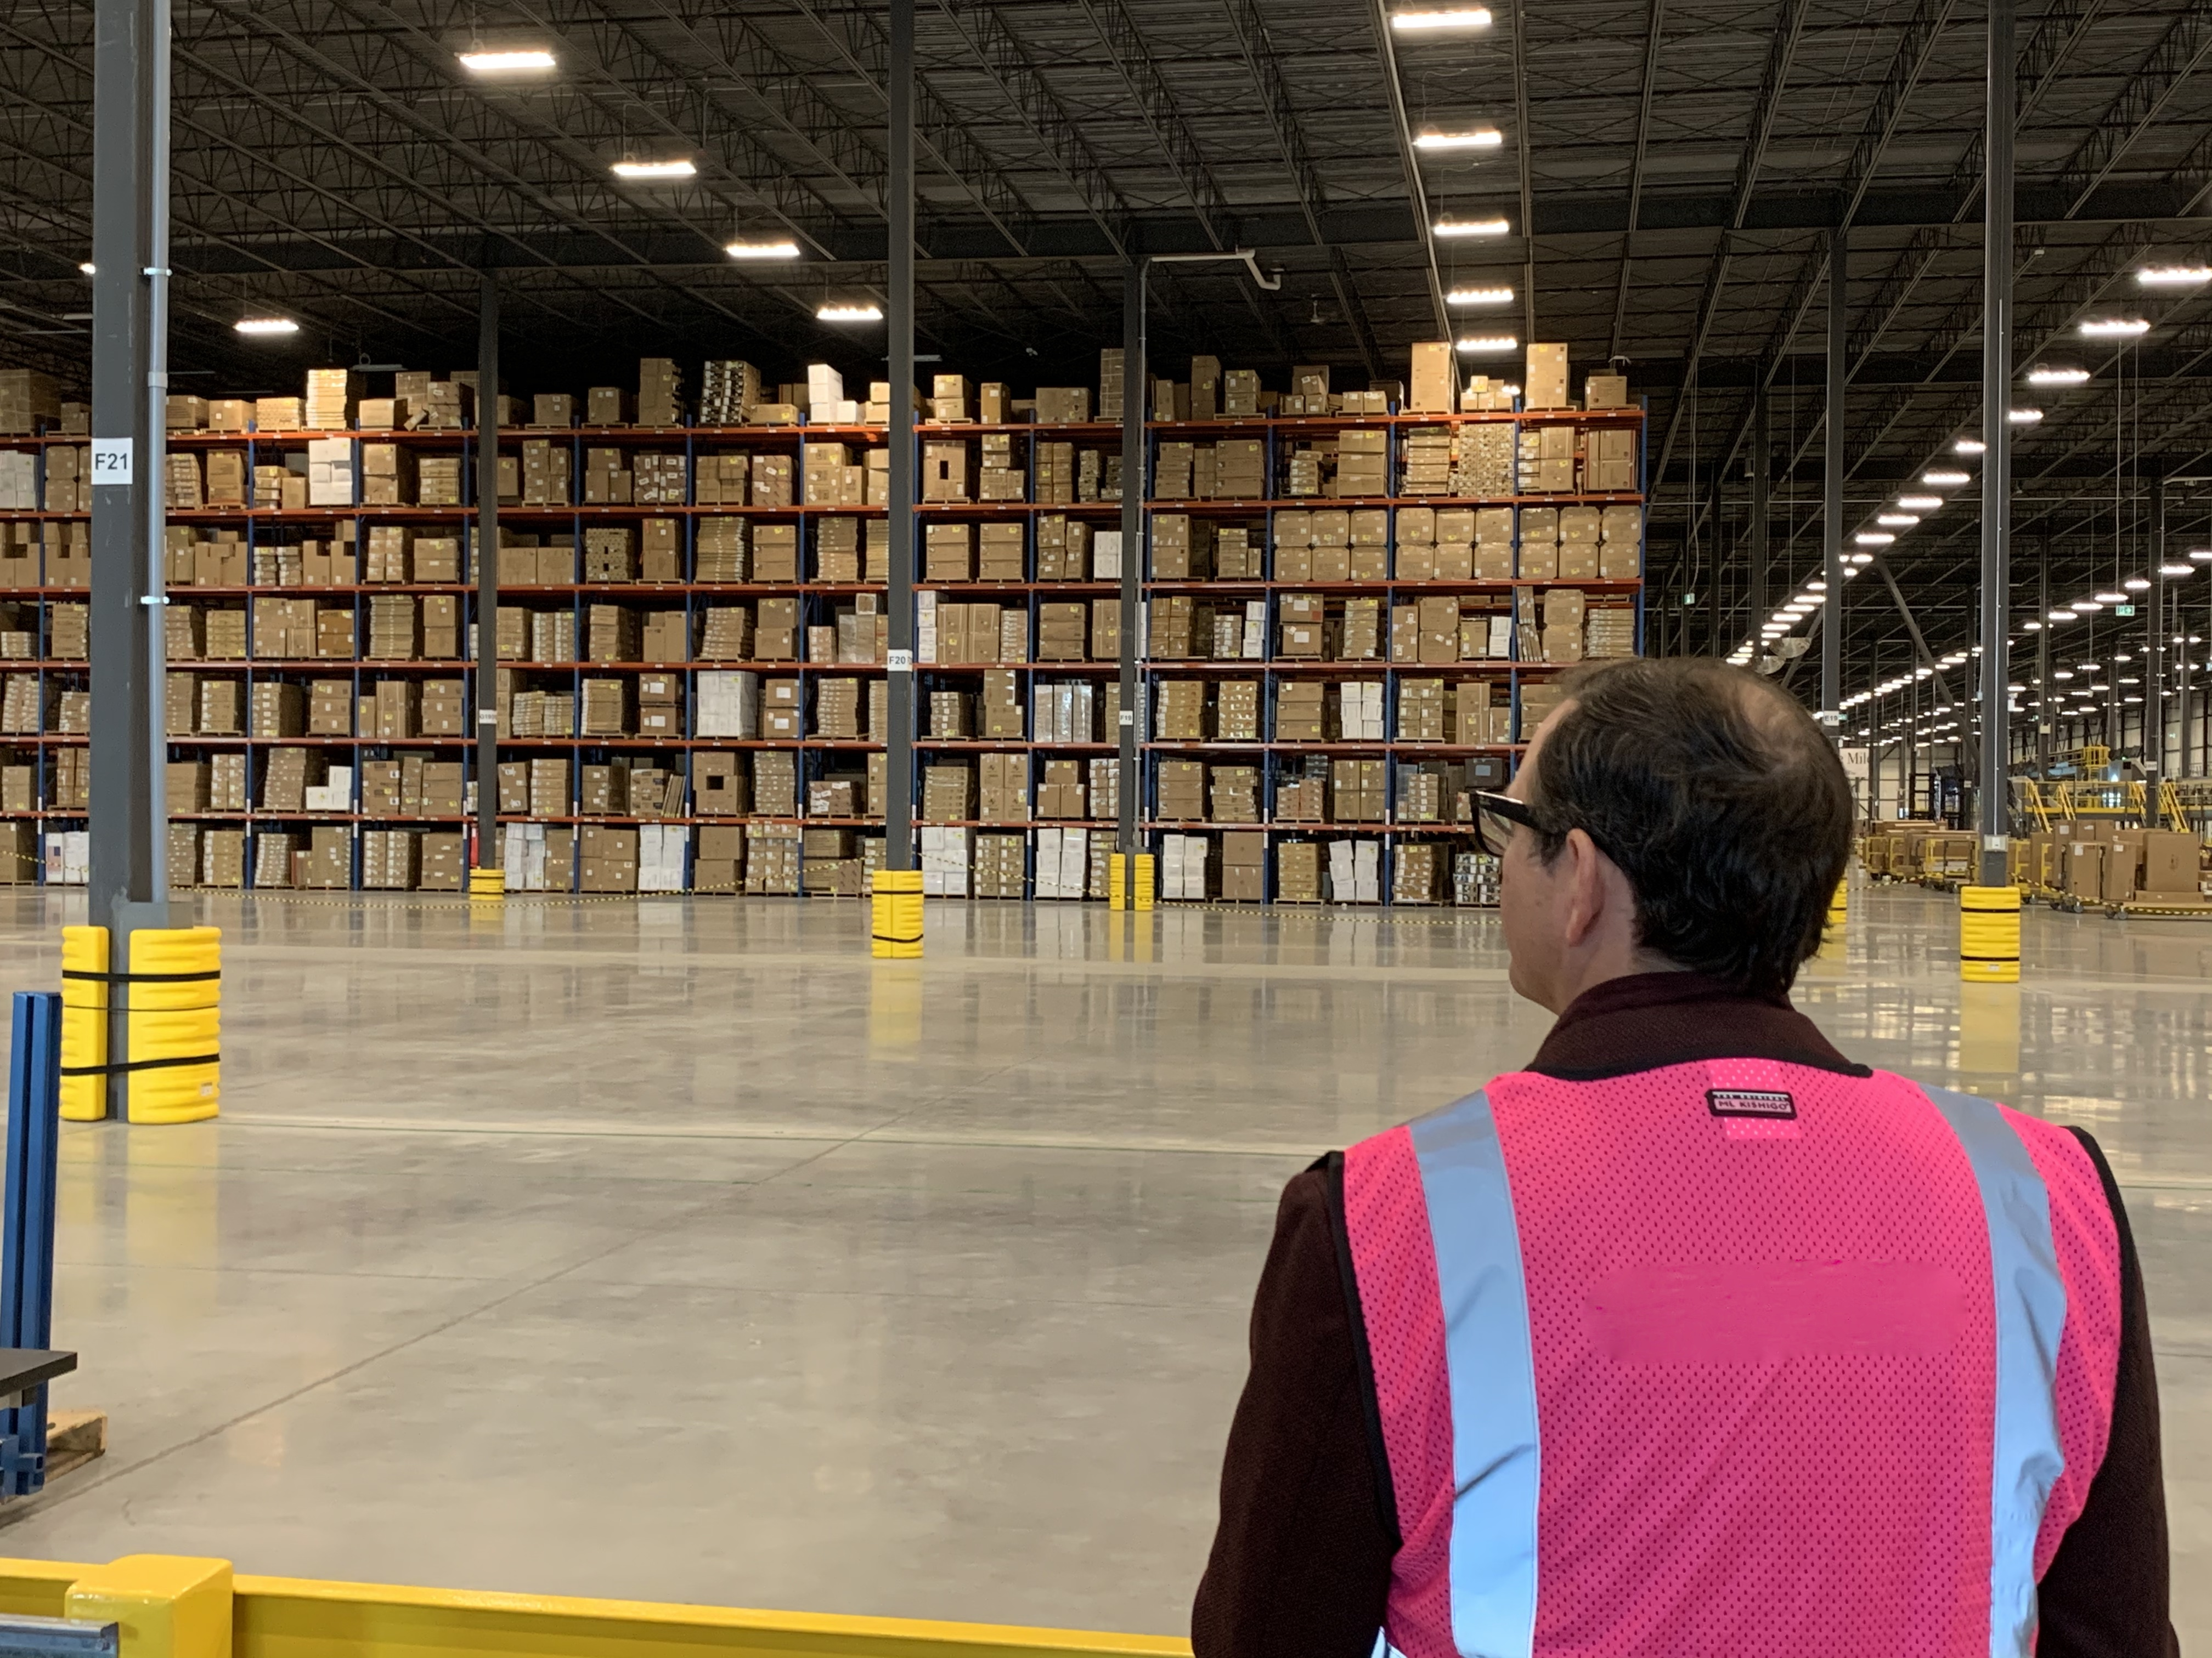
Turn your lift trucks into mobile profit centres
Optimizing Forklift Fleet Operations
with IVDT SkidWeigh Instrumentation Technology and RF Wireless InfoHUBX Gateway Start Up Kits

Slide 2
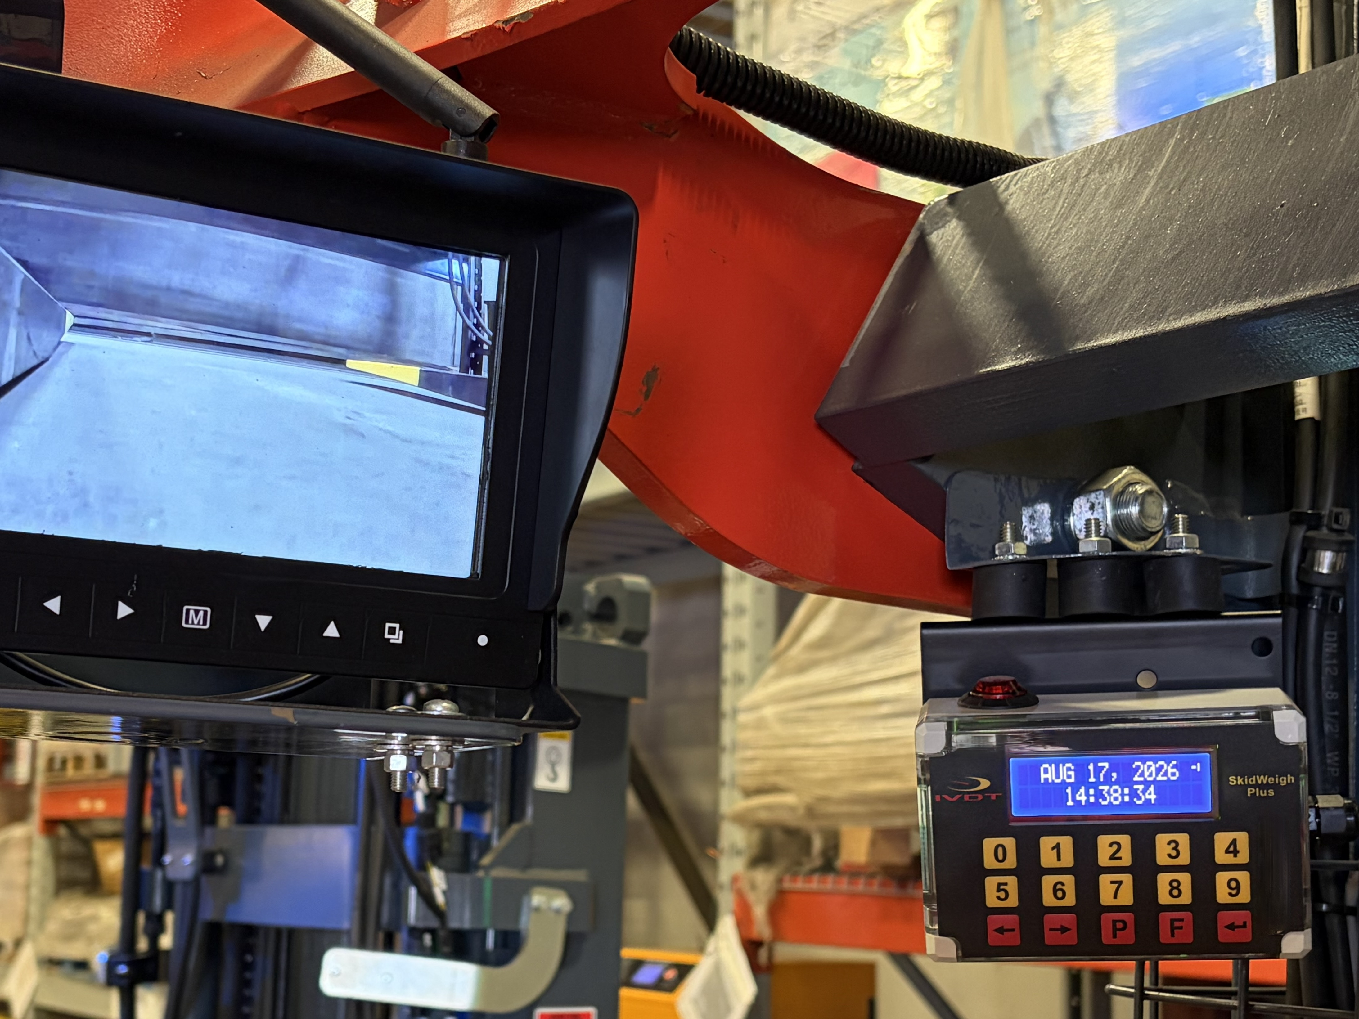
Are bottle necked floor scales, unmonitored material handling, and unexpected equipment damage stalling your warehouse throughput? If you want to squeeze maximum efficiency out of every shift, look no further than IVDT (Integrated Visual Data Technology).
IVDT’s flagship SkidWeigh product lines turn standard forklifts into smart, data driven productivity assets. Here is the ultimate breakdown of the top IVDT technologies to deploy right now for immediate operational gains.

Slide 3
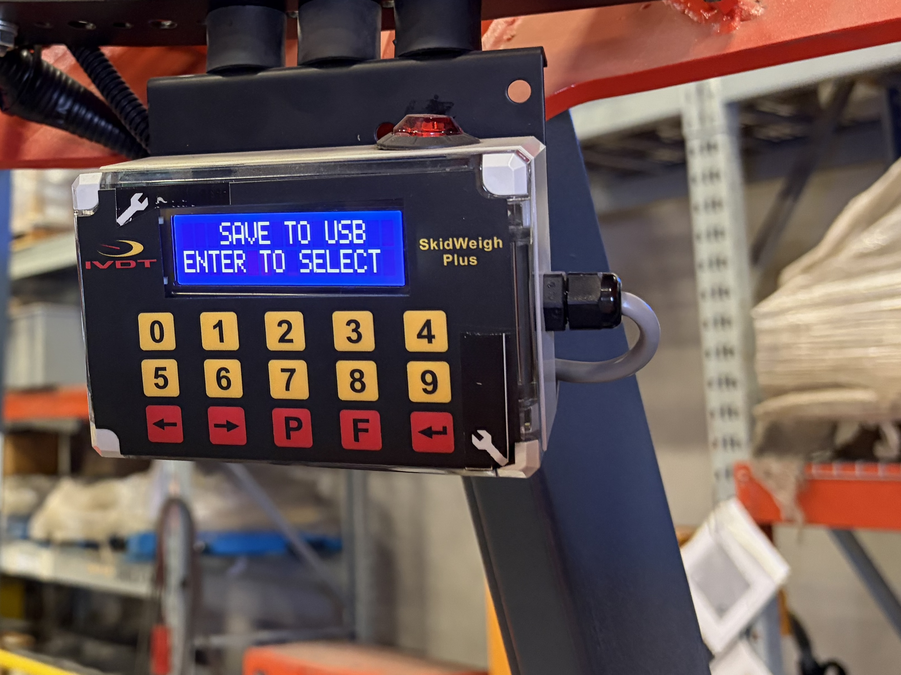
The 6 most common downtime codes
1. Weigh on the Fly: SkidWeigh Onboard Scales
Stop wasting time driving to centralized floor scales. IVDT’s SkidWeigh Classic (SC Series) and ED2 systems integrate directly into your forklift.
2. Turn Operational Idle Time into Action:
If you can't measure it, you can't improve it. The InfoHUBX ecosystem eliminates "ghost tracking" by recording true operational idling and justified downtime.
Identify Bottlenecks: Separate true product handling time from static vehicle idling.
Right Size Your Fleet: Access crystal clear utilization data to determine if you are overworking certain trucks or if you can downsize to save on capital overhead.
3. Safety Compliance that Moves Fast: Defender IM & Access Control
A single warehouse incident can shut down an entire aisle for hours. IVDT bridges the gap between safety compliance and rapid workflow.
Paperless OSHA Inspections: Digital pre-shift operator safety checklists require operators to pass compliance questions shown on an onboard screen before vehicle is operational, eliminating physical logs.

Slide 4
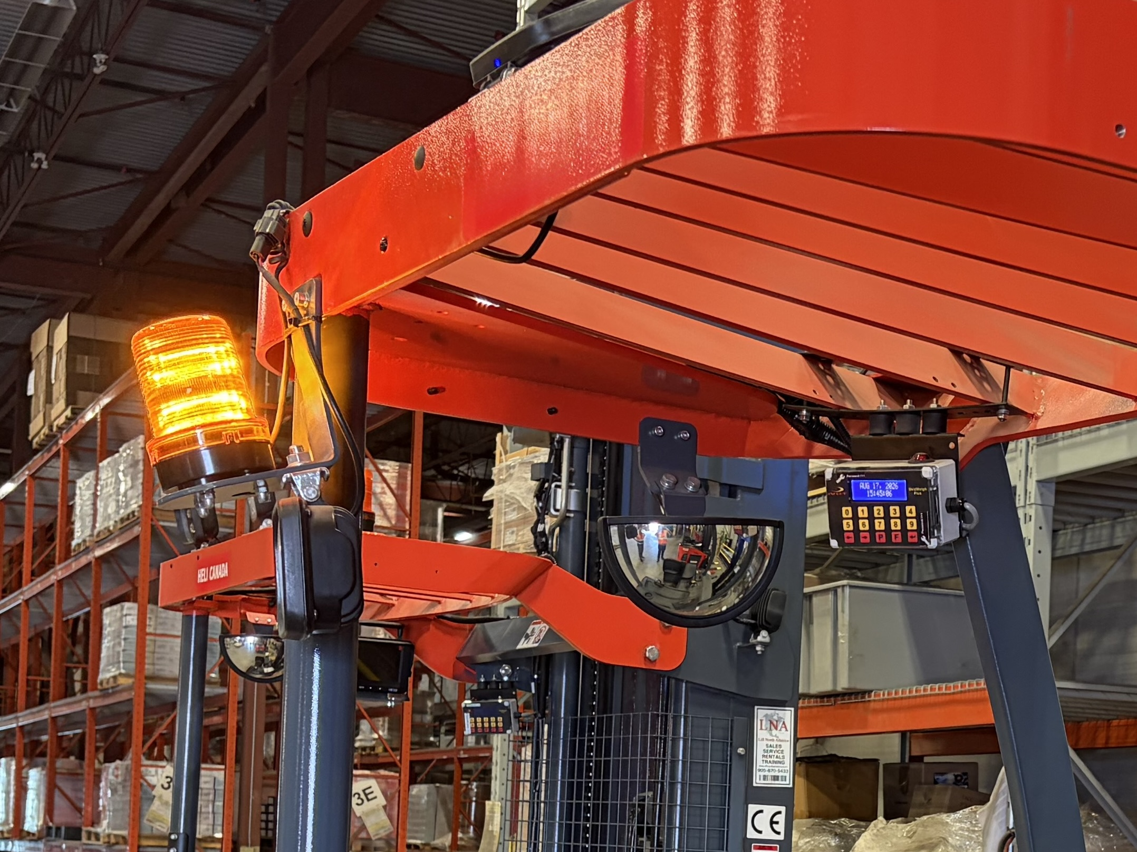
The 6 most common downtime codes
4. Zero Tolerance for Accidents: Overload & Impact Management
Protect your drivers, your racks, and your bottom line from costly structural damage.
Proactive Overload Alerts: Systems like the SC1, SC2 and SC4 trigger instant visual and audible alarms if a load exceeds safe capacity.
G-Force Impact Recording: The Defender IM Series logs real time impact data by operator ID, building a workplace culture of driver accountability.
5. The Cost of Floor-Scale Traffic
The Workflow Penalty: Operators must pick up a load, drive across the warehouse to a stationary scale, wait in line, drop the load, log the weight, pick it up again, and head to the staging area or trailer.
The IVDT Fix: Implementing the SC or ED3 series allows operators to weigh loads instantly during the natural lifting cycle with +/-1% accuracy. The integrated "Load Ready" notifications let drivers capture data with zero operational interruptions.

Slide 5
How to calculate your company's ideal threshold time
The Cost of Unmonitored Rack Impacts
The Workflow Penalty: Drivers hide collisions to avoid trouble, leaving structural rack damage hidden until an upright fails. Maintenance spends thousands on emergency racking repairs and reactive truck maintenance.
The IVDT Fix: The Defender IM3 Series uses an onboard accelerometer to detect G-force thresholds in real time. It logs the exact timestamp and operator ID, driving immediate accountability and preventing minor bumps from turning into costly aisle shut downs.
The Cost of Manual Paperwork
The Workflow Penalty: Drivers lose or pencil whip paper compliance logs. Supervisors spend hours filing sheets, yet you still risk heavy OSHA penalties if an inspector finds a missing or inaccurate pre-shift report.
The IVDT Fix: Upgrading to the SkidWeigh Plus ED3/4 Series digitizes the entire workflow. The system prompts the driver with a mandatory, paperless OSHA Safety Check on the digital display, and activating audio / visual alert completely until the electronic inspection is passed.

Slide 6
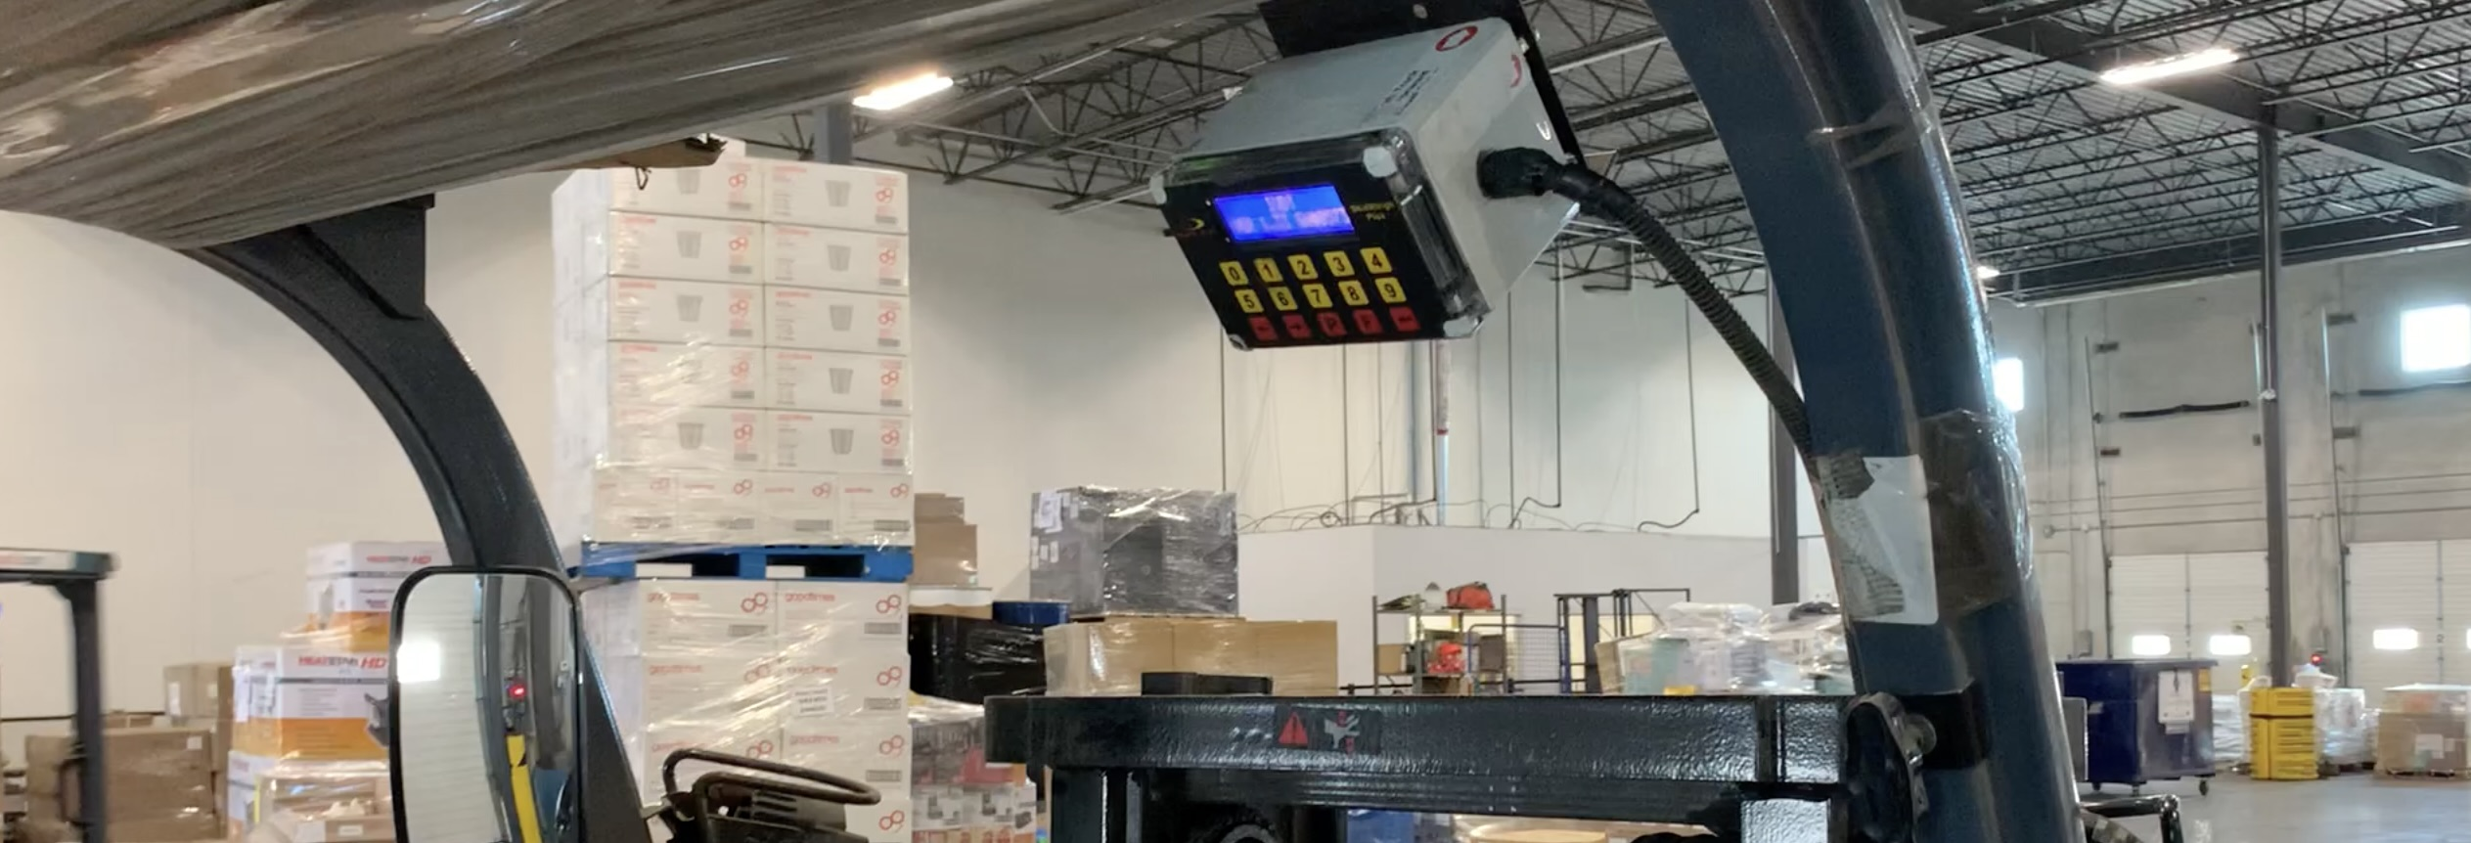
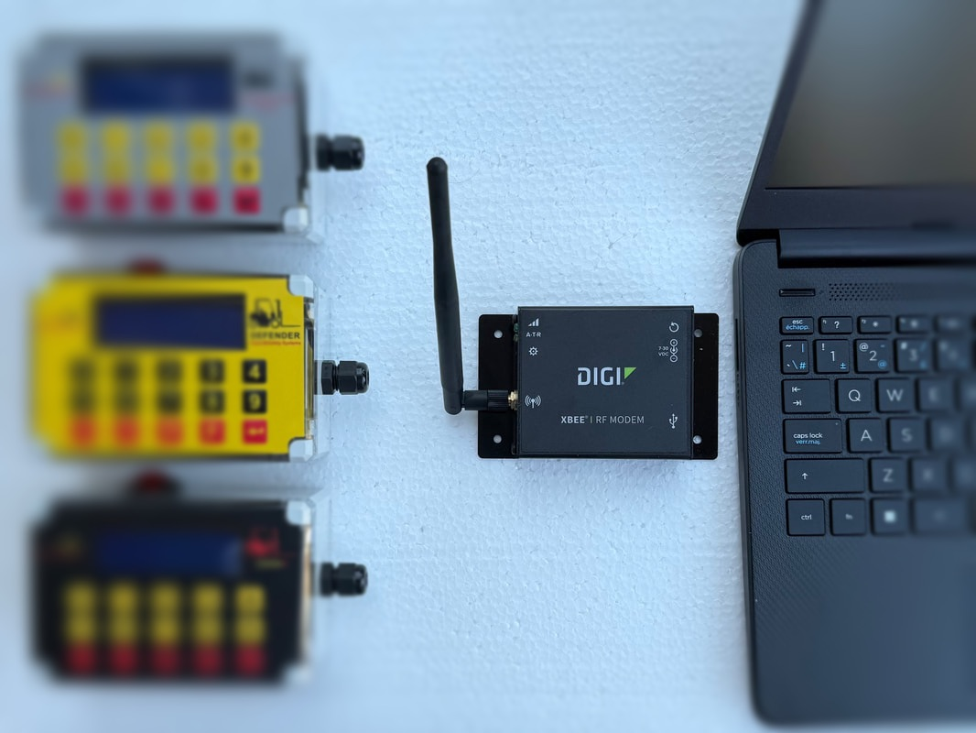
InfoHUBX Data Collection Kits are Modular Subscription-Free Telematics Hardware Packages
Manual USB extraction relies on a human supervisor physically walking out to each forklift, inserting a flash drive, downloading log files, and walking back to a computer to stitch reports together are for small operations. In a larger material handling operations, this manual step frequently gets forgotten, meaning critical data is lost or only looked at after an accident or efficiency drop has already happened.
For most material handling operations looking to maximize productivity, automated real-time wireless data extraction is vastly superior to manual USB/RF retrieval.
The IVDT's advanced fleet systems solve this by automating your data pipelines based on your infrastructure layout.
The IVDT InfoHUBX RF wireless gateway is an excellent choice for material handling fleets, specifically for small-to-mid-size operations that want to avoid recurring software fees and complex cloud setups. Manufactured by Integrated Visual Data Technology (IVDT), this on-premise system uses a 900 MHz RF mesh Digi network (Approved in USA, Canada and Australia) to transmit real time vehicle and safety telemetry directly to a local server or laptop.
InfoHUBX™ Operational Data Kits
Subscription Free Forklift Telematics

Slide 7
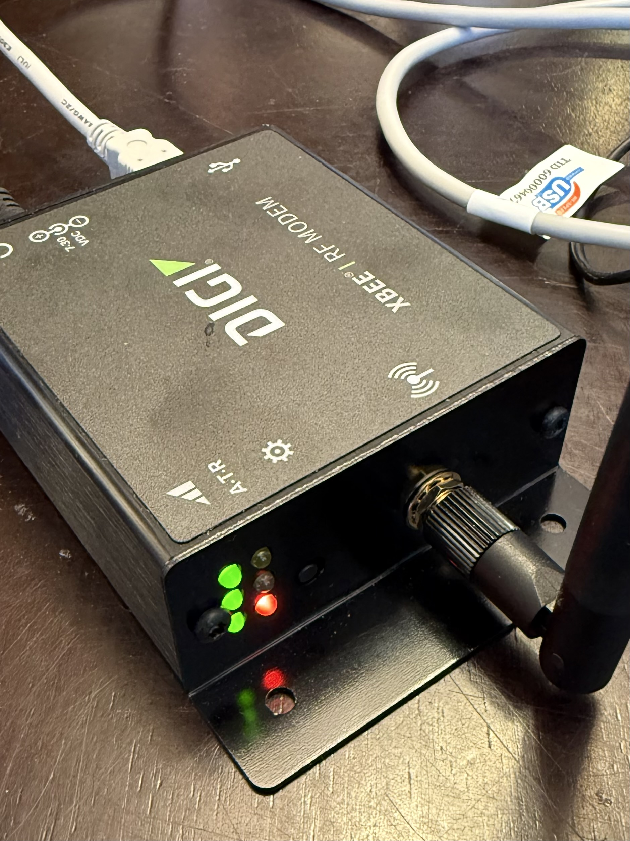
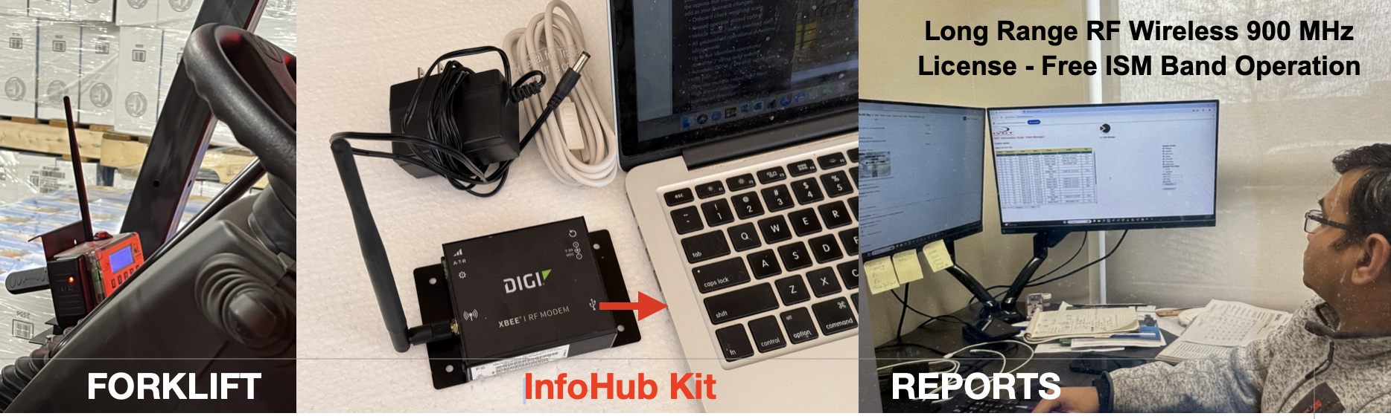
How to calculate your company's ideal threshold time
InfoHUBX Advantage
• Data Sovereignty: Because telemetry stays within your four walls,
sensitive operational data like operator IDs, productivity metrics, load
weights, impacts, OSHA compliance and facility blind spots never
leaves the local network.
• Infrastructure Independence: The 900 MHz DigiMesh RF network
(Approved in USA, Canada and Australia) operates on its own dedicated
industrial band. It does not compete for bandwidth with your existing
corporate Wi-Fi or warehouse inventory scanners.
• Hardened Reliability: The onboard instrumentation logs events
locally on the forklift. If a truck drives out of RF range (such as into a
deep cold-storage unit or a shielded shipping container), it securely
stores the data and automatically dumps it the moment it reestablishes a handshake with the InfoHUBX gateway.
• Instant Local Alerts: Impact and overload alerts do not travel to an
external cloud server and back. Instead, the InfoHUBX gateway
triggers instant notifications over your Local Area Network (LAN) to
alert floor supervisors immediately.
www.skidweigh.com

Slide 8
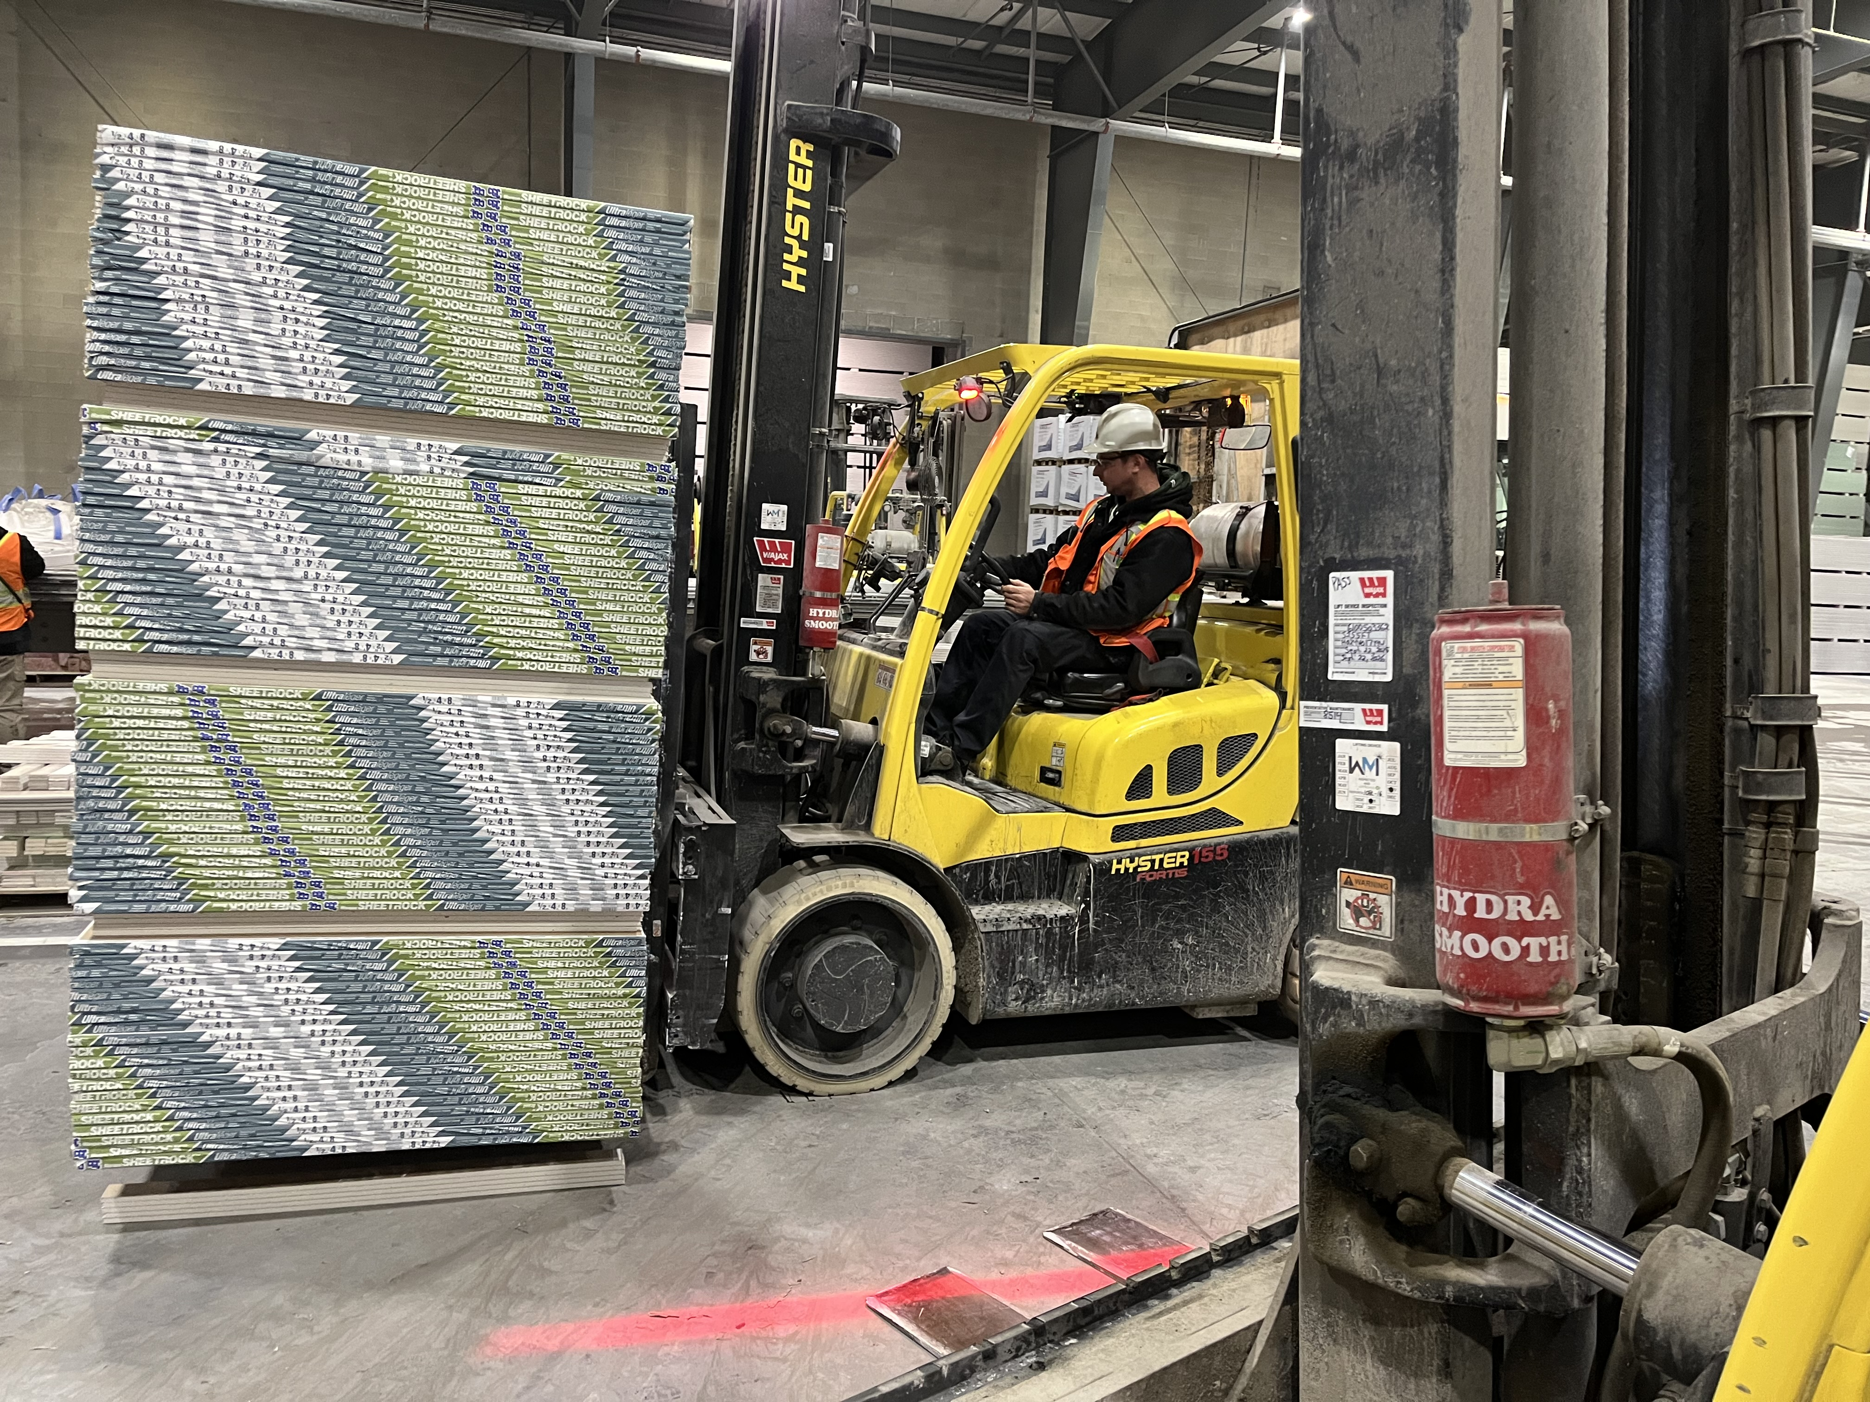
How to calculate your company's ideal threshold time
Driving Fleet Efficiency
Through Advanced Forklift Instrumentation Technology

Slide 9
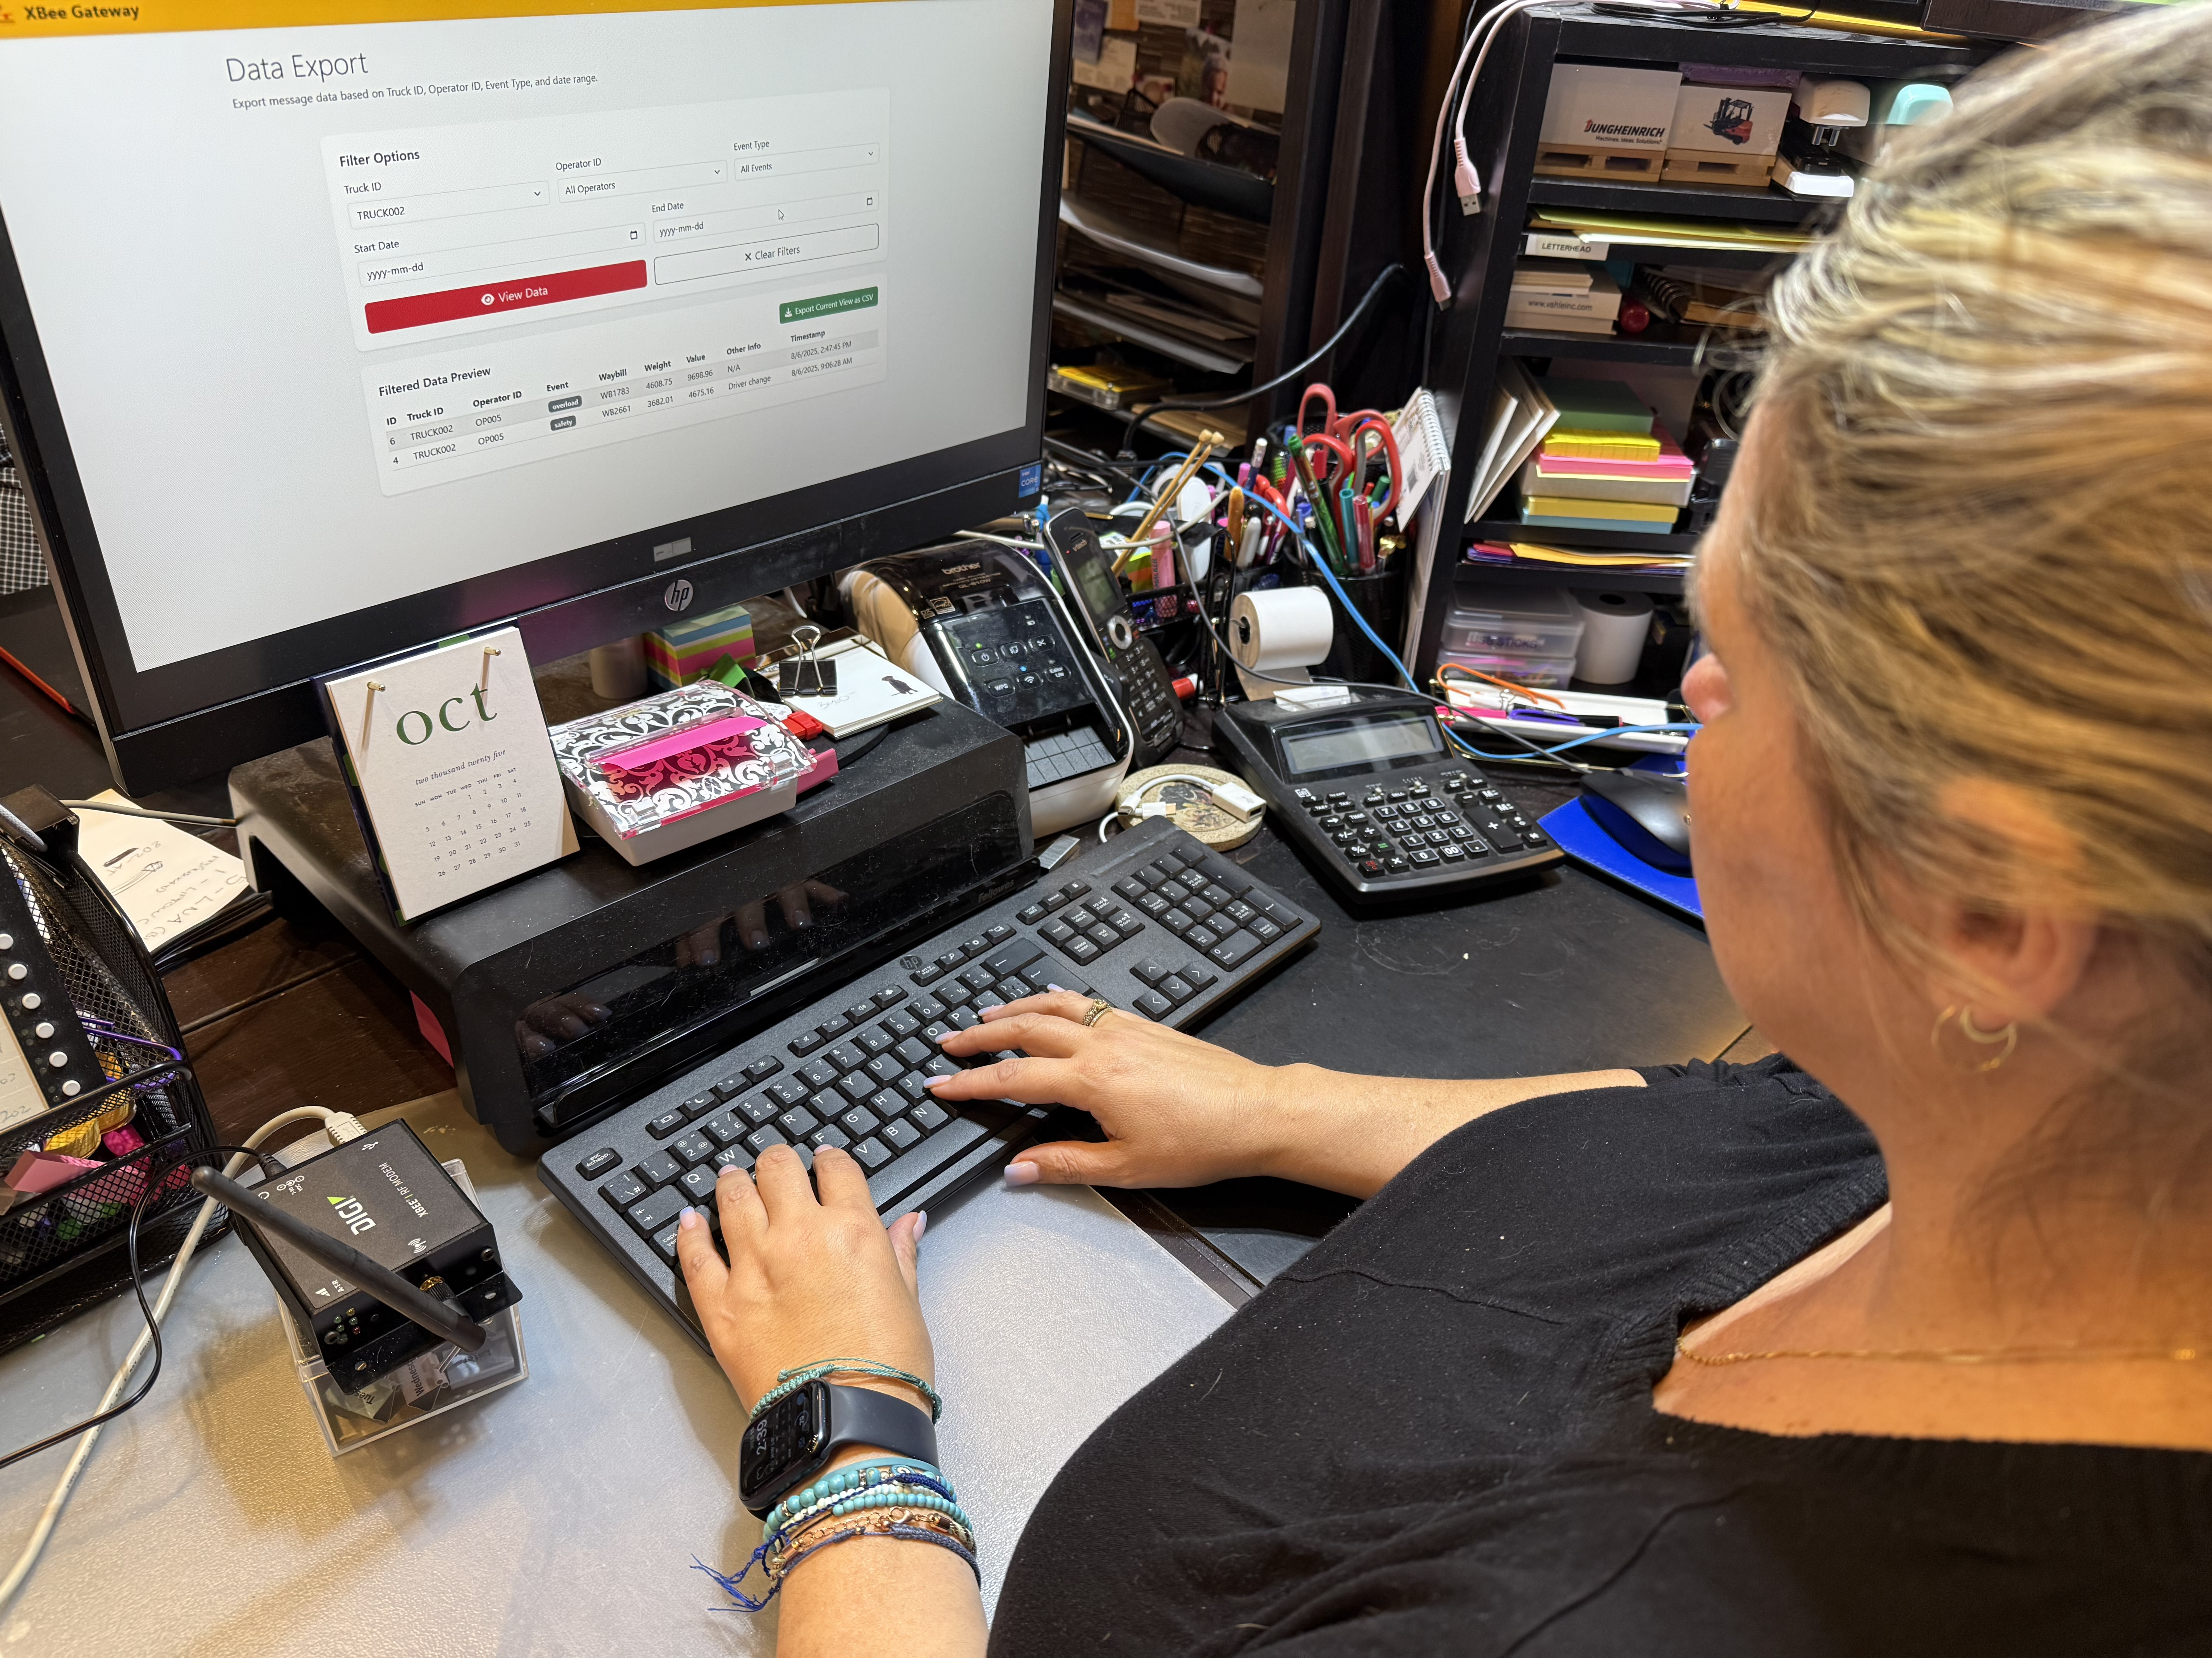
How to calculate your company's ideal threshold time
InfoHUBX Gateway Kits
Each Kit Comes with
*One ED3 SkidWeigh Plus Classic
*One InfoHUBX kit With Software
** Customer can add as many ED3 as required to connect to InfoHUBX gateway, ,no additional charge

Slide 10
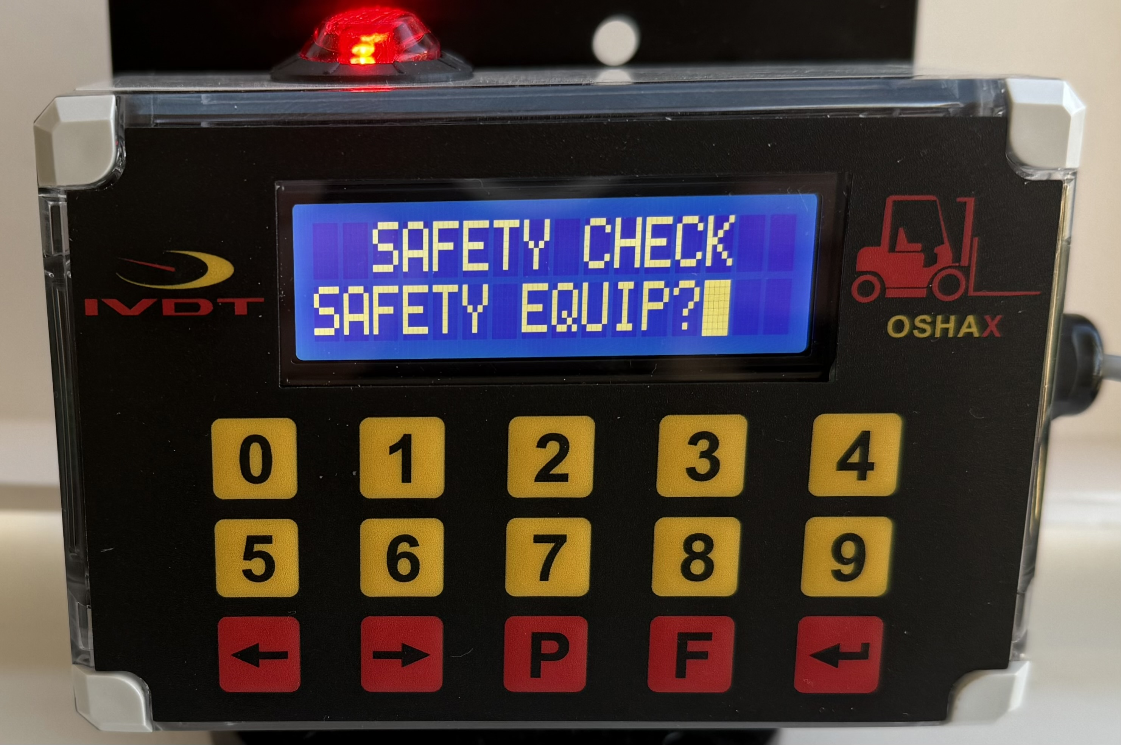
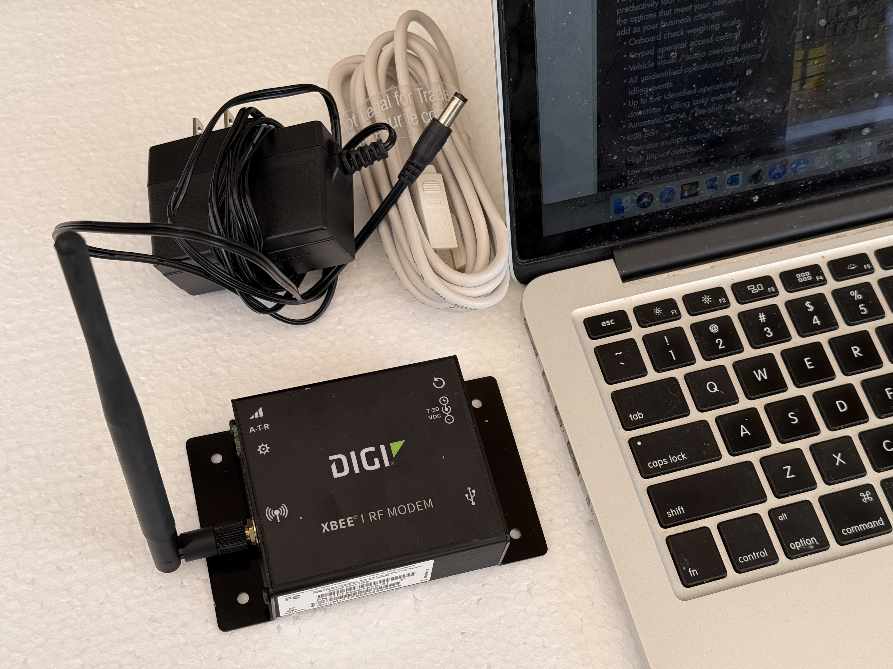
How to calculate your company's ideal threshold time
Order No.
IHX-OSHA * Automatic safety check compliance
Default every 8 hours, 12 and 24
Sessin start time
* Time to complete safety check
Real time clock
Operator ID# keypad input
Vehicle ID#
Audio / visual alert (Remainder to operator to initiate safety check)
Vehicle operation not disabled
Optional Hardware
Vehicle Impact Detection
RFID Operator Card Reader -*Lift

Slide 11
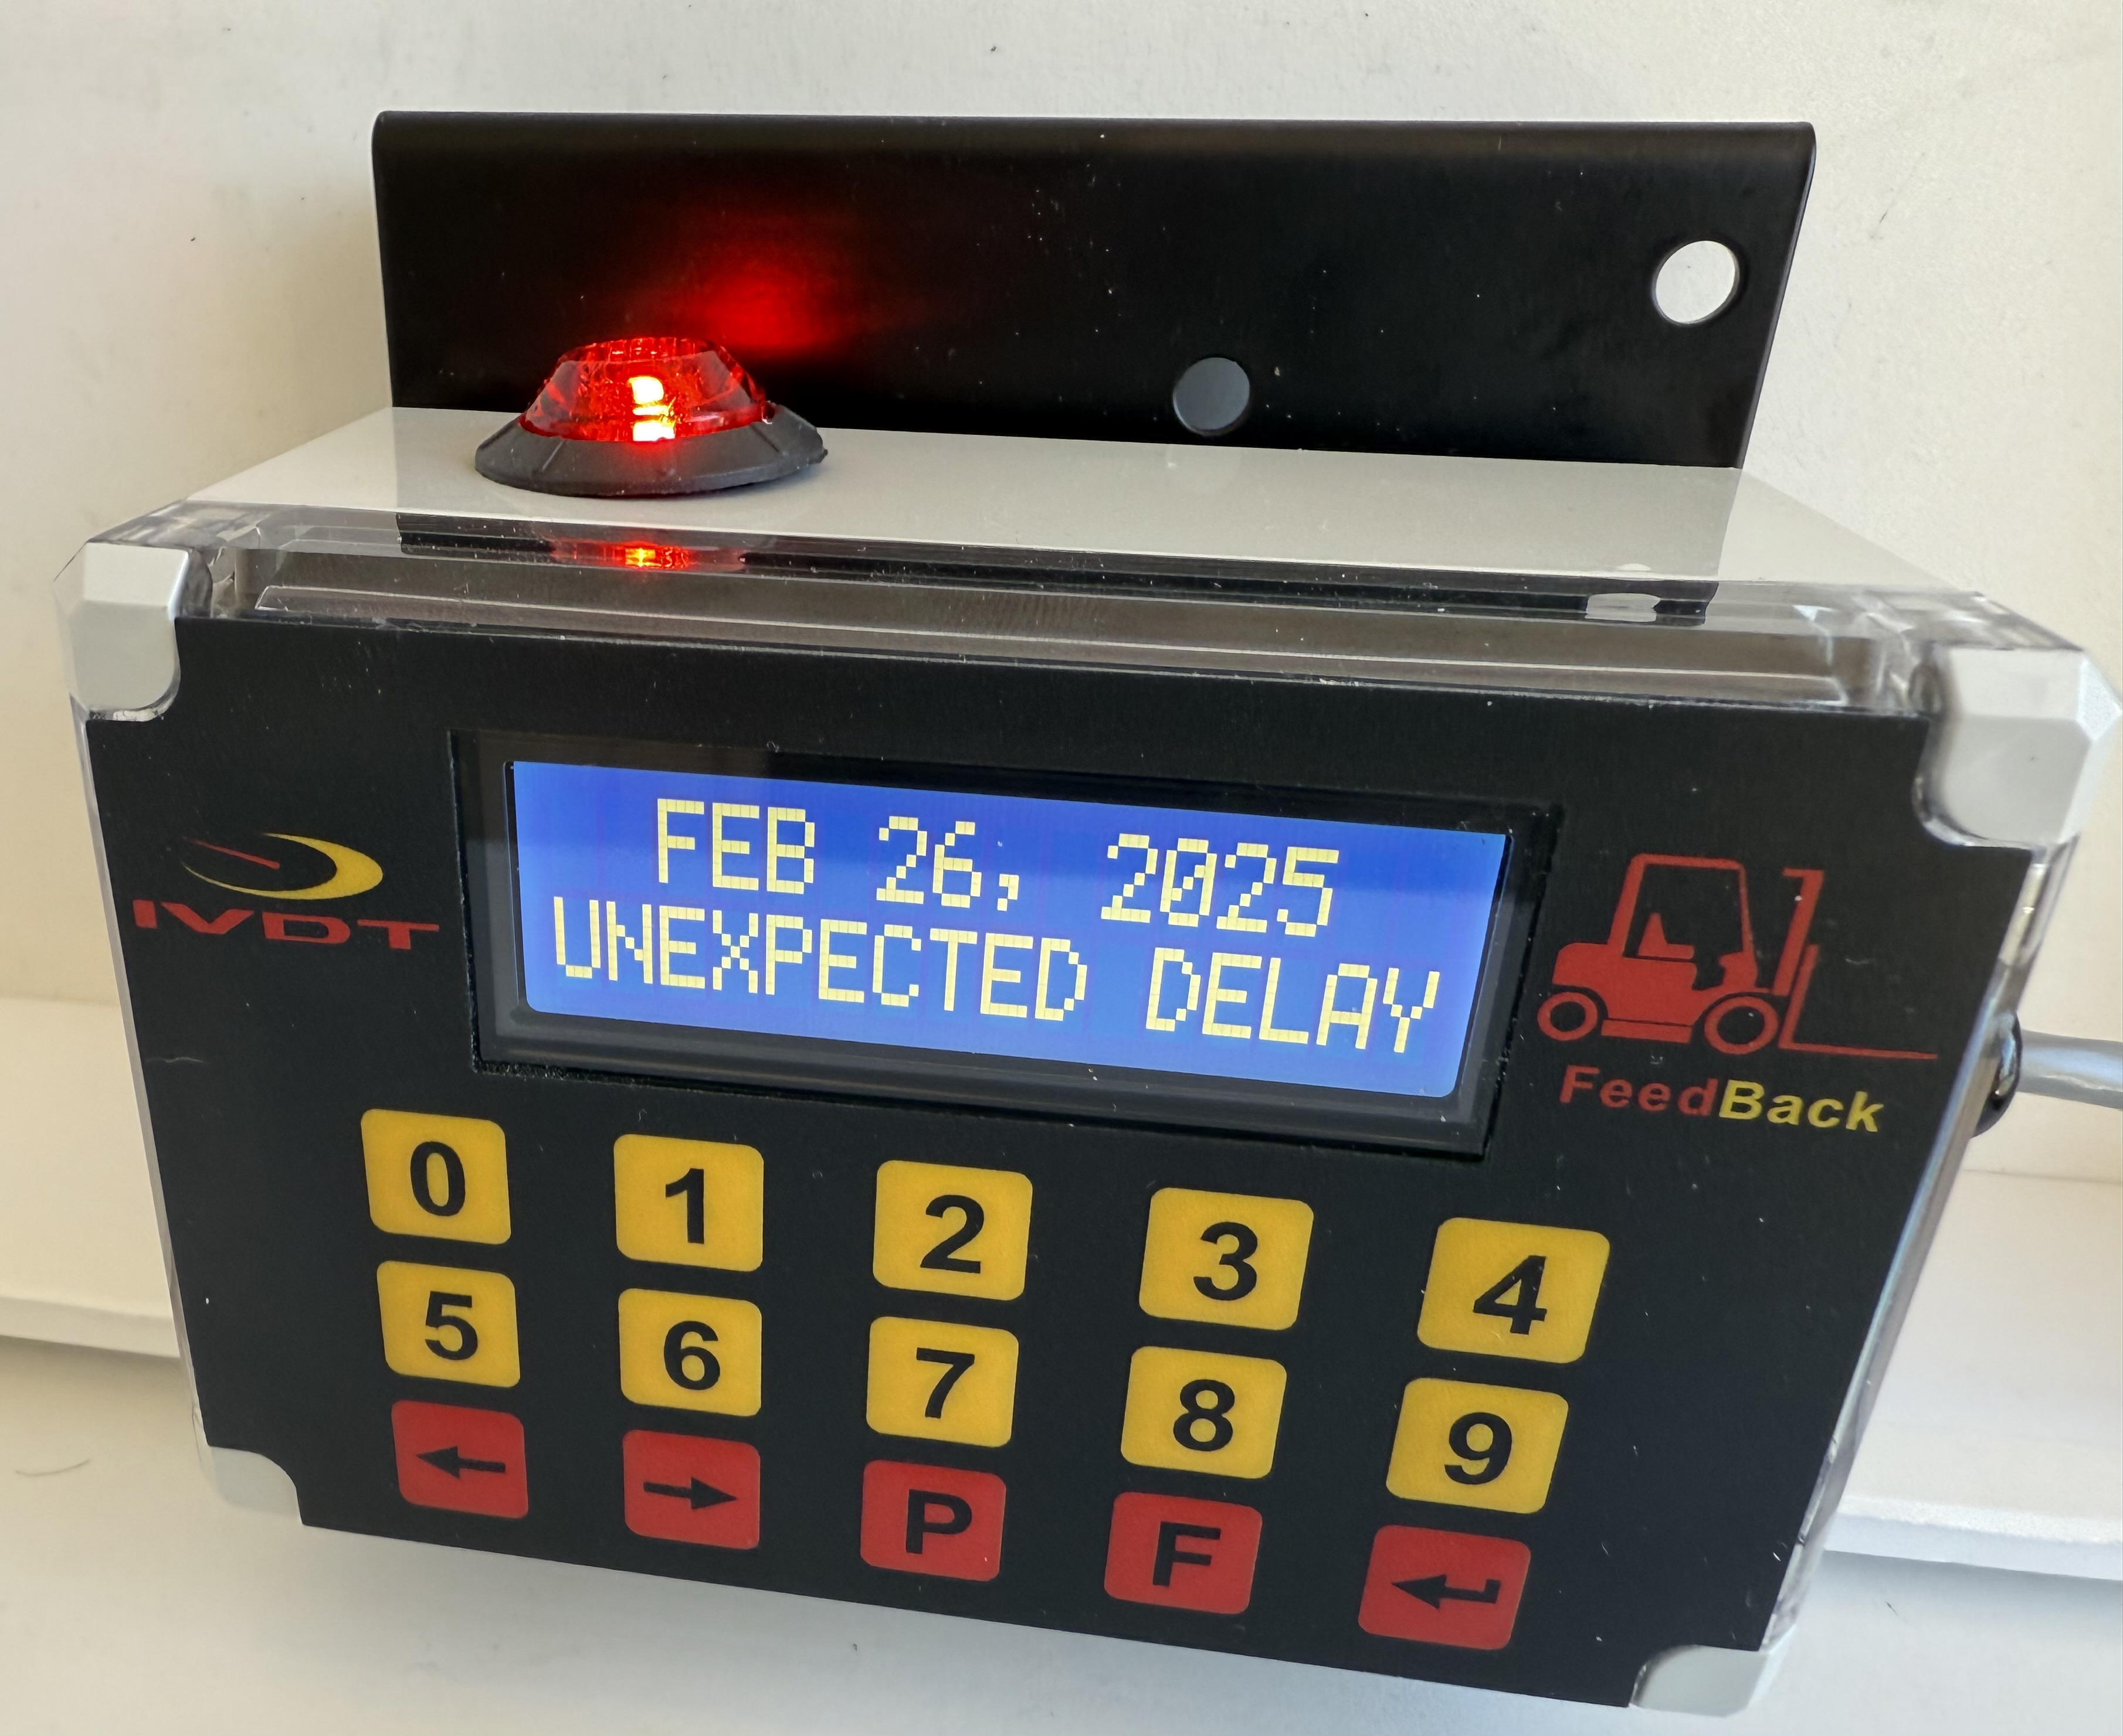
Order No.
IHX-IDLING
Sessin start time
Audio / visual alert (Remainder to operator to input valid ID#.
Real time clock
Operator ID# keypad input
Vehicle ID#
Automatic detection of all unidentified idling events within company utilization factor, (Audio / visual alert)
Operator input for 5 justified operational downtime reasons
Vehicle operation not disabled
Optional Hardware
* Automatic safety check compliance
Vehicle Impact Detection
RFID Operator Card Reader
Check the Plate
Before You Lift

Slide 12
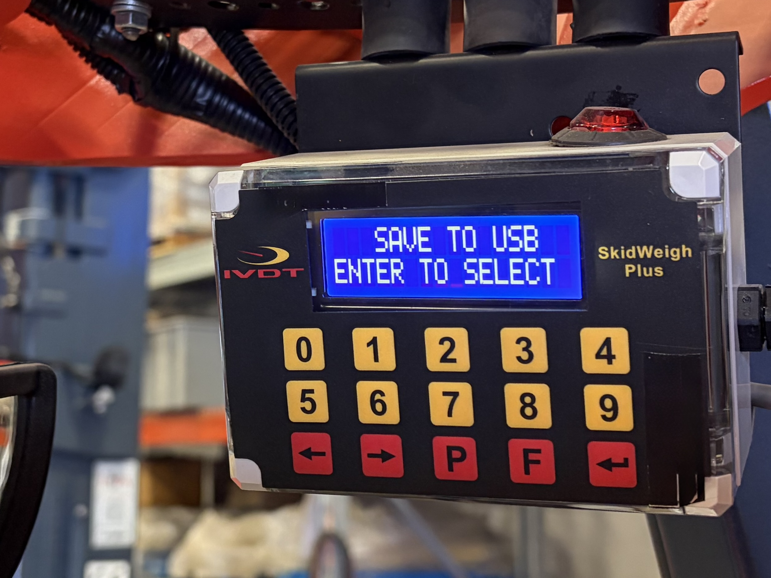
Order No.
IHX-OVERLOAD
Sessin start time
Audio / visual alert (Remainder to operator to input valid ID#.
Real time clock
Operator ID# keypad input
Vehicle ID#
Automatic detection of all vehicle overloads. (Audio / visual alert)
Vehicle operation not disabled
Optional Hardware
* Automatic safety check compliance
Vehicle Impact Detection
RFID Operator Card Reader
Weight scale

Slide 13
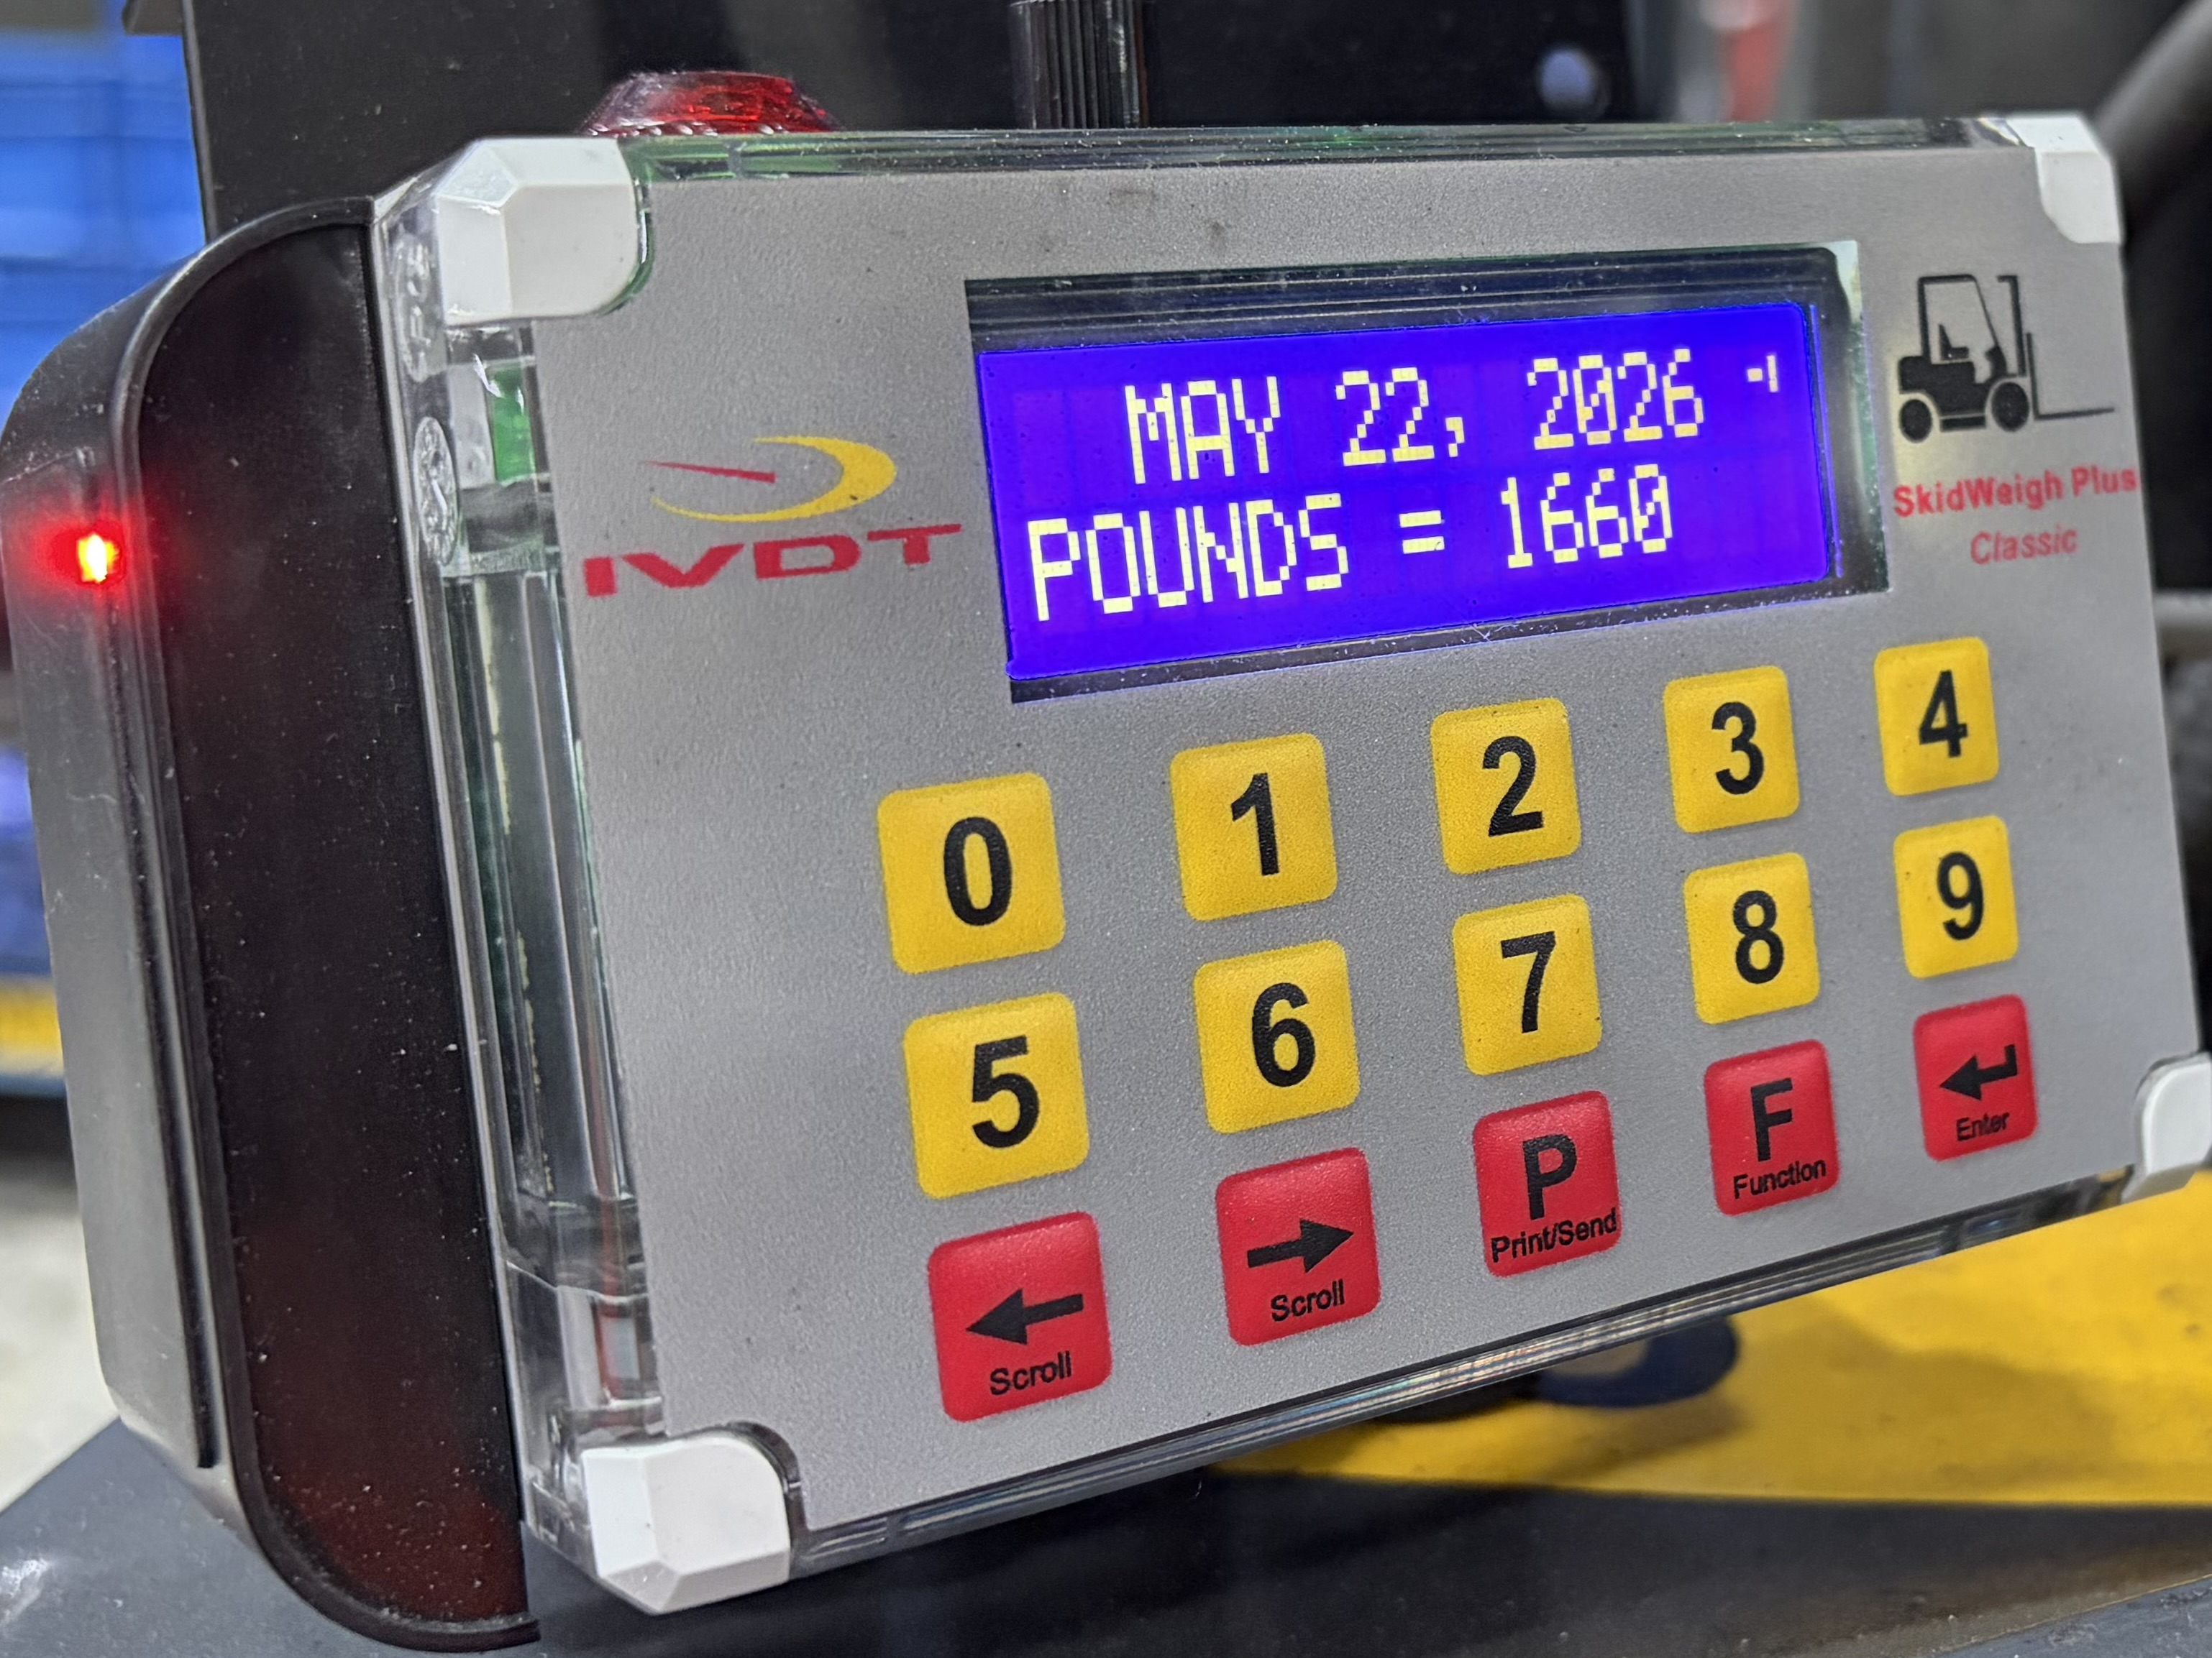
Order No.
IHX-WEIGHT
Sessin start time
Audio / visual alert (Remainder to operator to input valid ID#.
Real time clock
Operator ID# keypad input
Vehicle ID#
Weight scale
Accumulative load weight
Vehicle operation not disabled
Optional Hardware
* Automatic safety check compliance
Vehicle Impact Detection
RFID Operator Card Reader
Overload
Bluetooth module for mobile printer

Slide 14
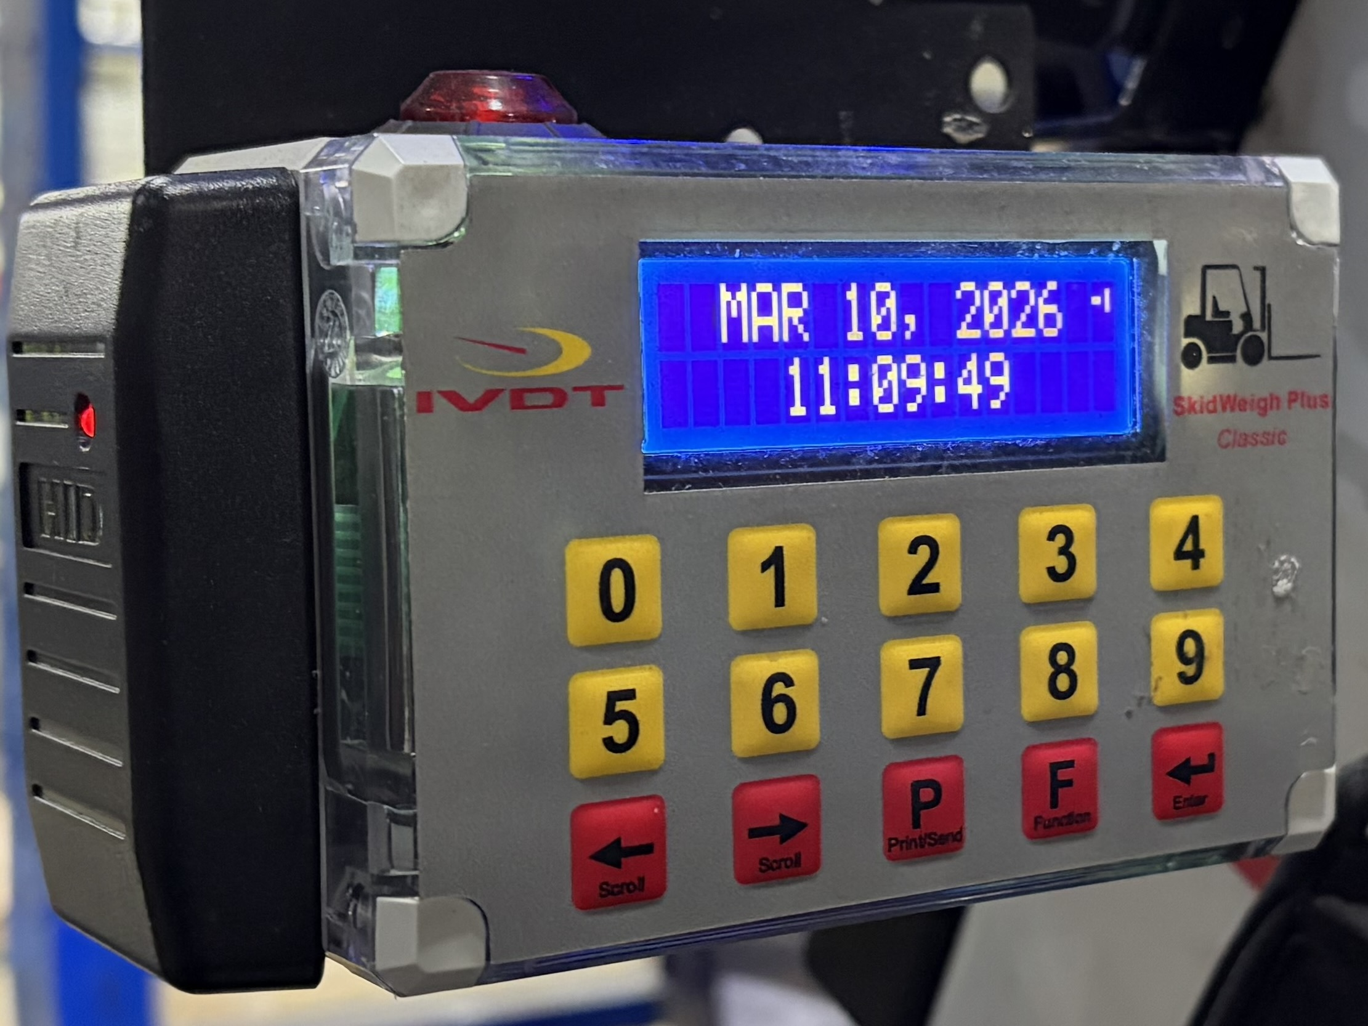
Order No.
IHX-IMPACT
Sessin start time
Audio / visual alert (Remainder to operator to input valid ID#. (Audio / visual alert)
Real time clock
Operator ID# keypad input
Vehicle ID#
Impact detection (Audio / visual alert)
Vehicle operation not disabled
Optional Hardware
* Automatic safety check
RFID Operator Card Reader

