Slide 1
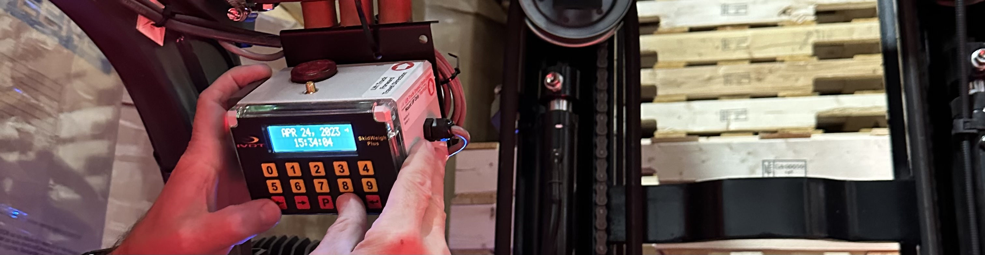
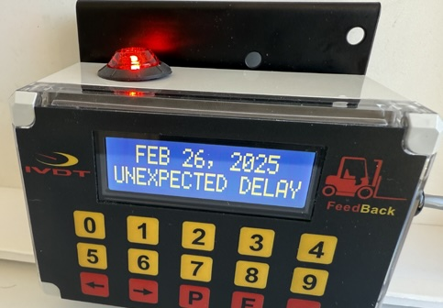
www.skidweigh.com
FeedBack
The Introduction of the ‘Company Utilization Factor’
Integrated Visual Data Technology Inc.

Slide 2
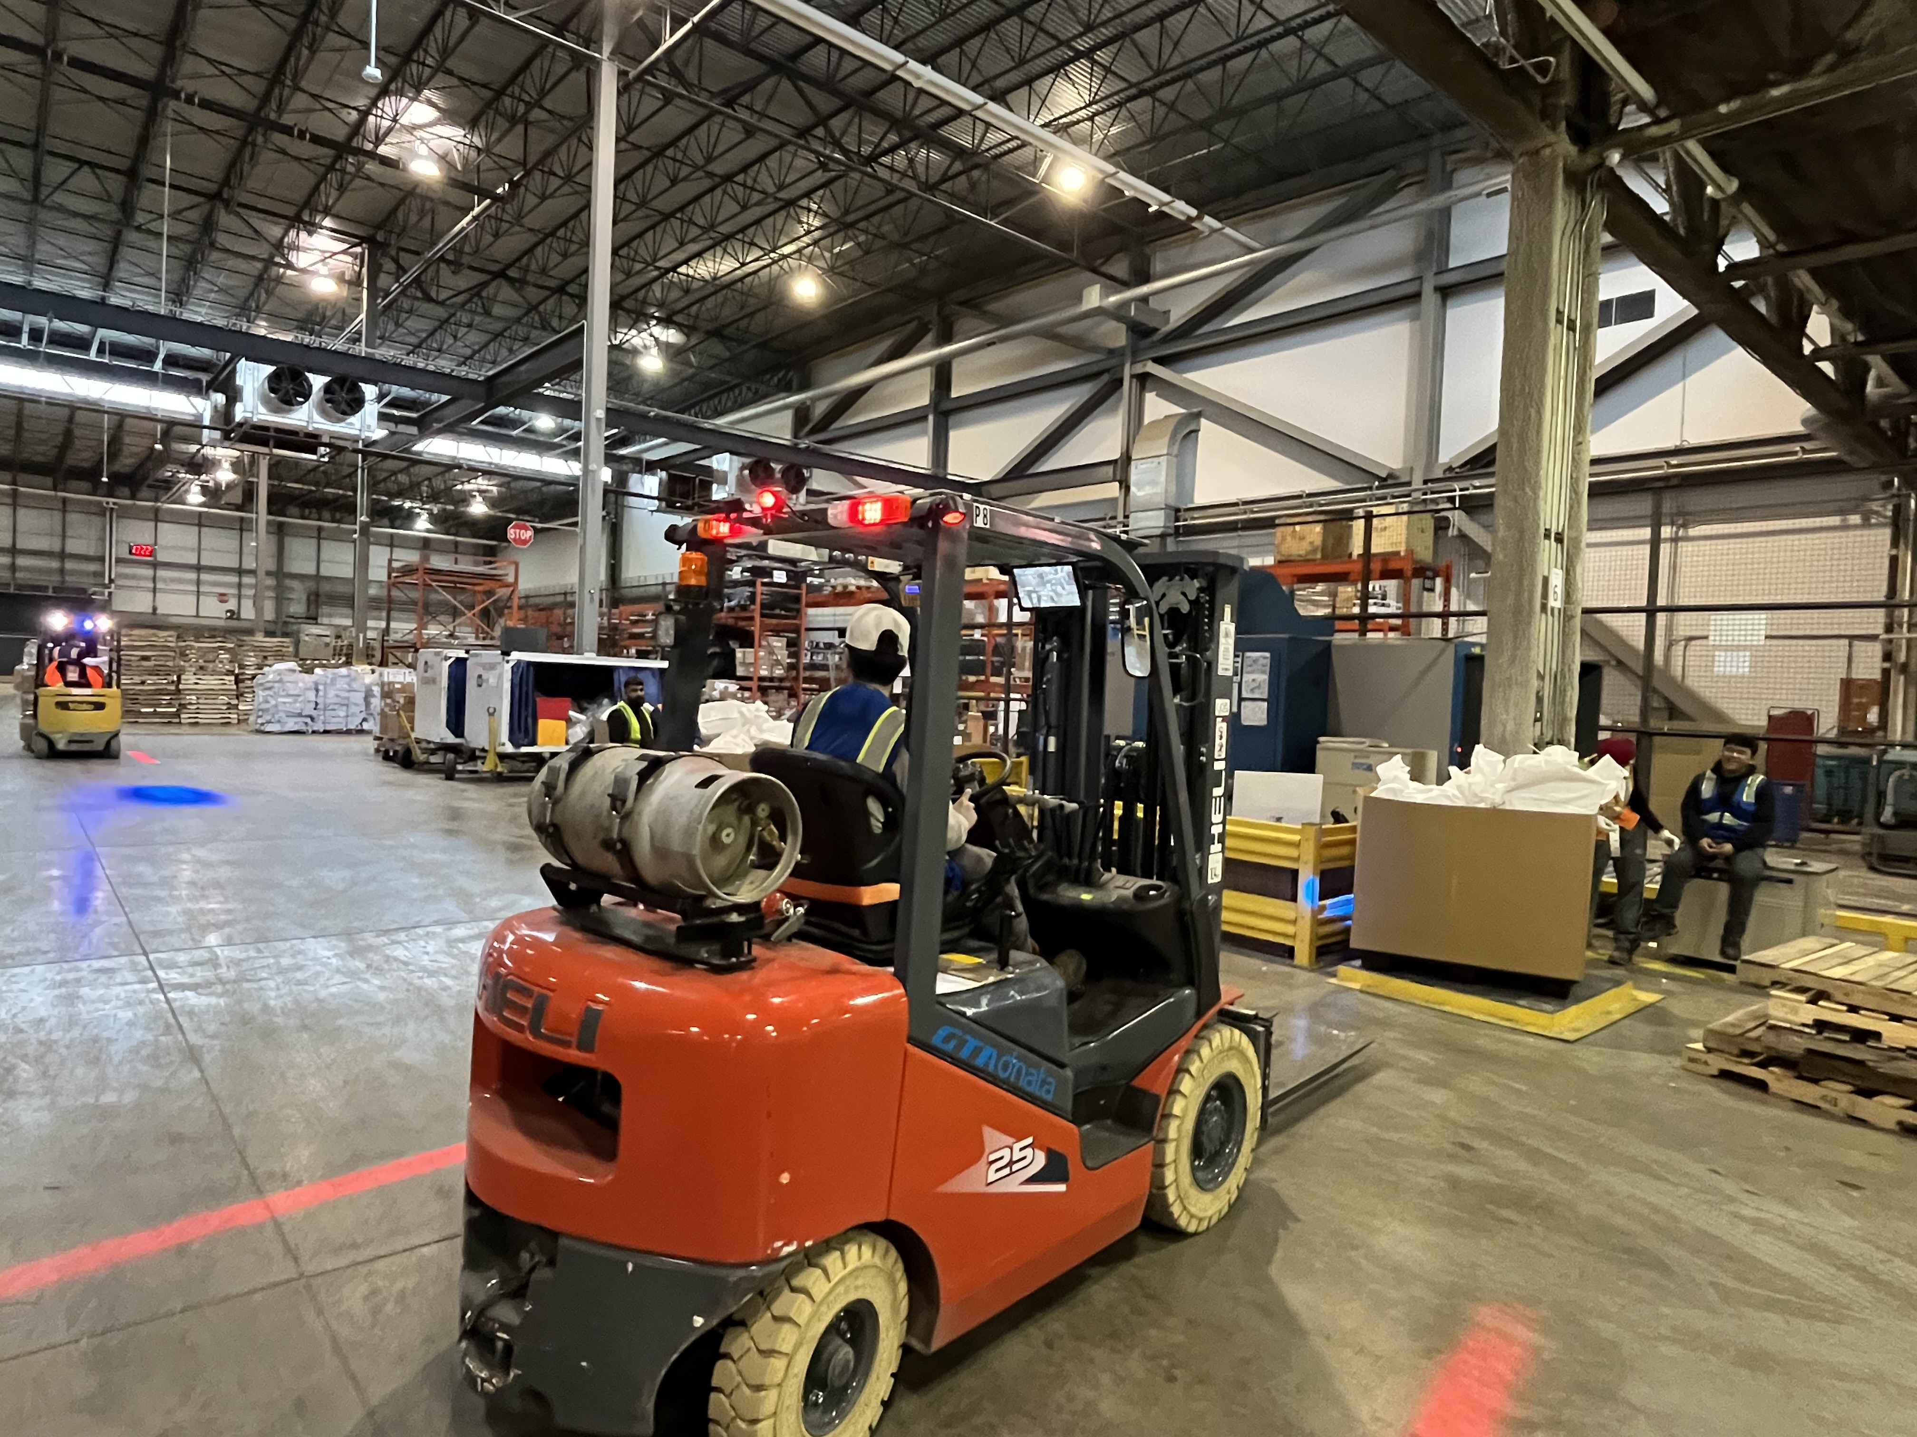
The Core problem: WHY TRADITIONAL FLEET UTILIAZATION TRACKING FAILED
PRIOR TO IVDT, fleet managers suffered from massive operational data gaps. Traditional hour meter with lift times measurements ‘sensor only’ telematics could not distinguish between a forklift actively waiting in a staging queue versus an operator sitting idle, unproductive or justified idle tasks.
FACT ABOUT FLEET PRODUCTIVITY
All material handling operations are somewhat different, even within the same industry.
Companies often do the same things in different ways; therefore, the inefficiency will vary significantly. The reality is that little is known about the root causes of lift truck operational downtime and subsequently its impact on production overall. The solutions to reduce the operational inefficiency is found by emphasizing the importance of implementing fully automatic operational idling / downtime monitoring on each forklift in real time.
'GHOST’ UTILIZATION
RANDOM BOTTLENECKS
POOR OPERATIONAL PLANNING
Forklift ignition could be active for 8 hours, but the vehicle might only be productive for 2. Creating the illusion of productivity.
Delays caused by waiting for paperwork, battery changes or any material flow blockage remain unrecorded. These gaps are rarely recorded accurately.
Mis-calculations in peak demand and scheduling of labor and forklifts create unknown production gaps.

Slide 3
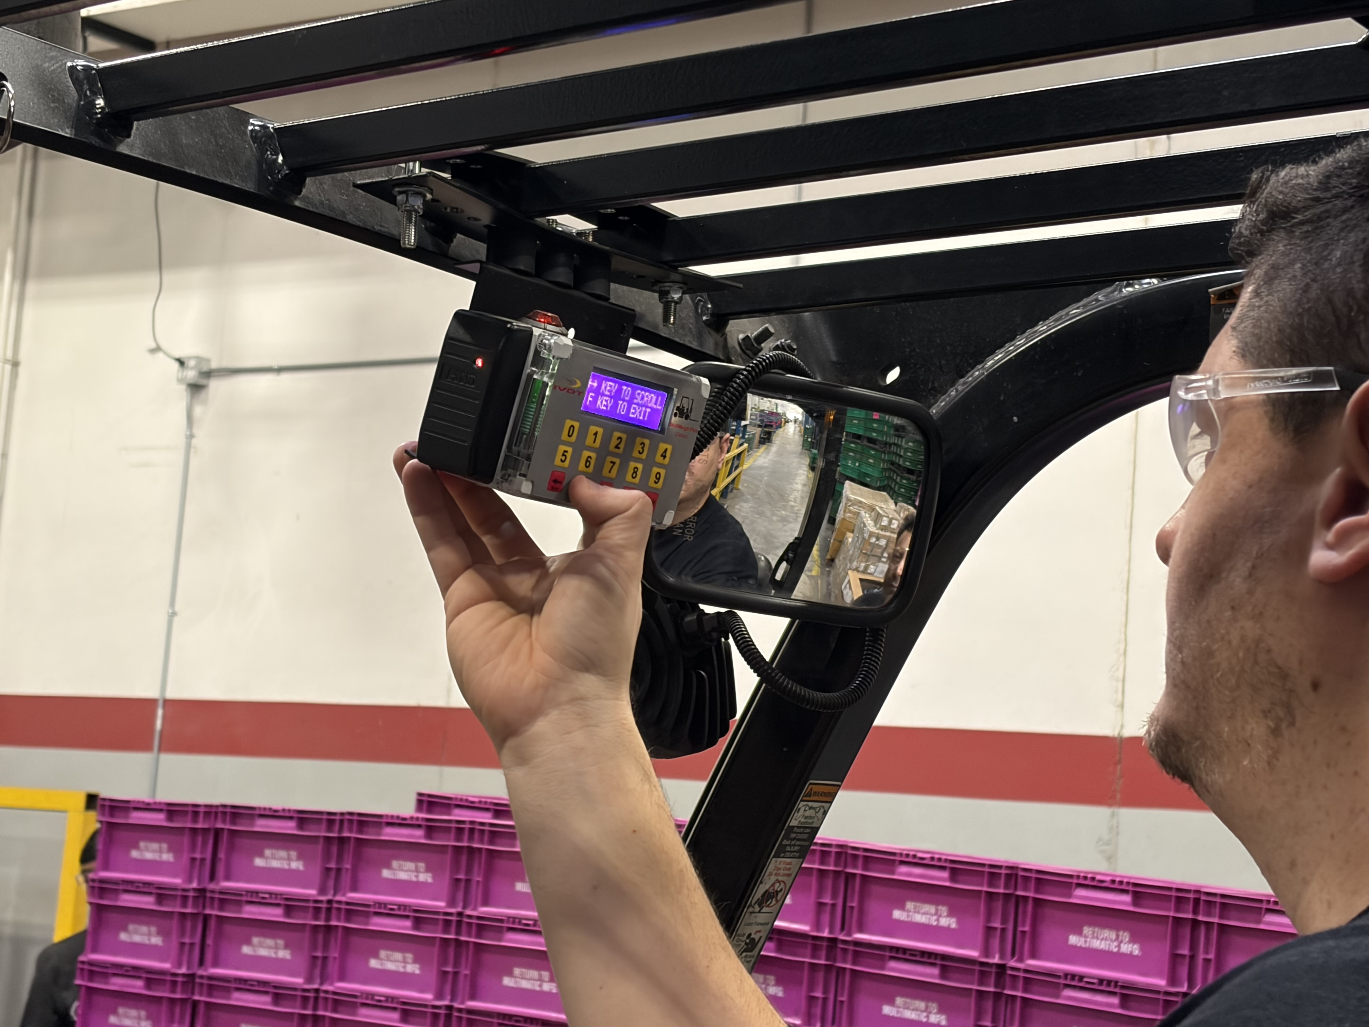
How ivdt’s feedback automates vehicle tracking
The IVDT system uses an intelligent, automated workflow software with an algorithm to capture every hidden downtime event without requiring constant administrative oversight. Below are the Key Elements of the Automated Loop.
01
The Company Utilization Factor: This is a manager-defined, password
protected threshold (such as a 2-minute default) programmed directly into the
onboard system. It establishes an engineered standard tailored to the specific
facility's pacing.
02
Audio Visual Interventions: The moment a lift truck sits idle past the
programmed utilization threshold, the onboard In-Vehicle Display Terminal (IVDT)
triggers a physical alert. This instantly notifies the driver of excess idling.
03
L
The 5 Second Timeout: The system gives the operator exactly 5 seconds to
select a pre-configured, justified operational downtime active task reason from a
custom menu (e.g., "waiting for order", "material delay").
04
Automatic Unidentified Logging: If the operator fails to input a reason within 5
seconds, the software automatically records the event as an "Unidentified
Operational Downtime" event. It records this data alongside the Operator I
05
Zero Subscription Data Routing: All logged events are compiled locally into
Excel/CSV file formats via a physical USB port or pushed in real time over long-
range RF wireless communication to an on premise InfoHUBX Gateway,
eliminating recurring cloud software fees.

Slide 4
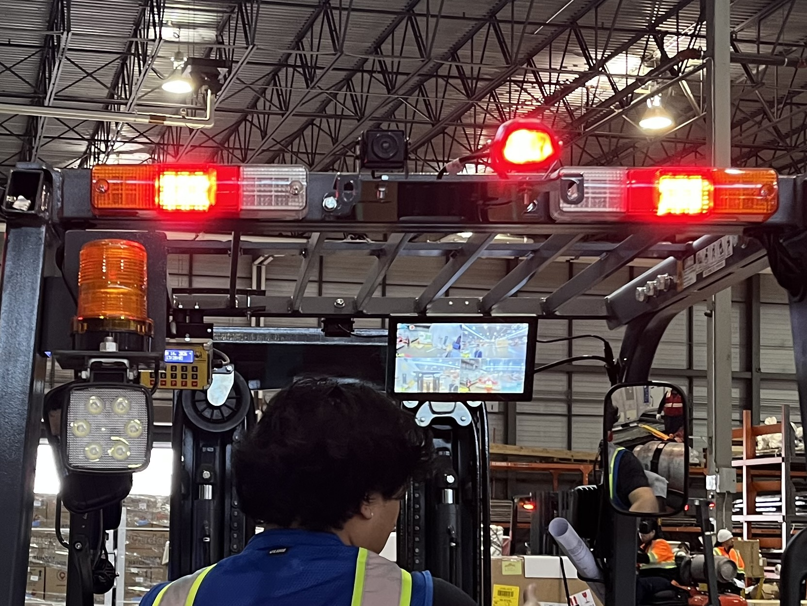
The 6 most common downtime codes
The IVDT FeedBack system allows you to program up to six customized
Justification codes. When the forklift exceeds its operational idle threshold,
the operator selects one of these codes to classify the bottleneck.
• 1. Blocked / Staging (STG): Used when aisles are blocked by
inventory or the operator is stuck waiting in a congested shipping bay.
• 2. Paperwork / Scan (PAP): Accounts for time spent confirming
orders, waiting for bills of lading or resolving inventory system sync errors.
• 3. Battery / Fuel (BAT): Tracks the time spent driving to, waiting for,
or executing battery swaps and propane tank changes.
• 4. No Material (MAT): Identifies upstream production delays where
the forklift is ready, but the product is not yet manufactured or picked.
• 5. Housekeeping (HOU): Covers mandatory shift wrap-up tasks, such as
clearing shrink wrap, stacking empty pallets, or cleaning spills.
• 6. Wrap / Banding (WRP): Logs the necessary operational pause when an
operator must leave the cabin to manually stretch wrap a pallet load.

Slide 5
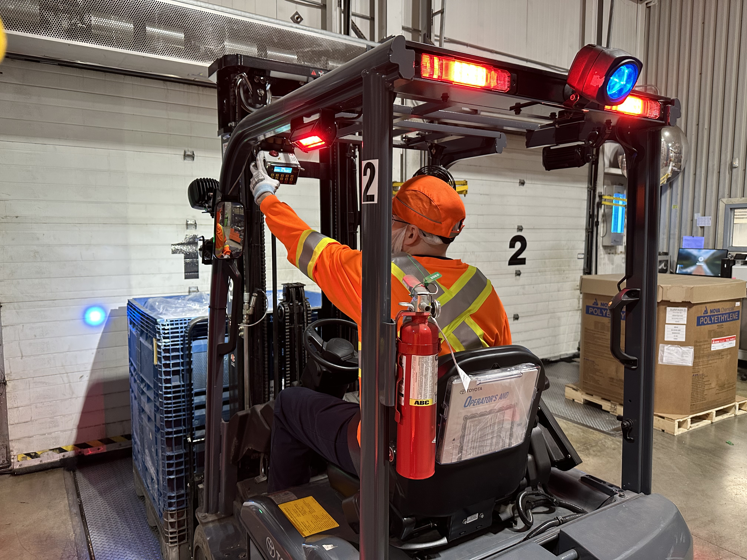
How to calculate your company's ideal threshold time
The "Company Utilization Factor" threshold should not be a guess. Setting it too short
causes operator fatigue from constant alerts; setting it too long misses critical hidden
downtime.
Use this step-by-step formula to establish your baseline:
[Average Travel Time Between Furthest Nodes] + [Standard Safe Drop/Pick Time] =
Ideal Threshold
1. Measure Travel Time: Time a standard trip from your furthest inbound dock to
your furthest outbound storage rack. (e.g., 45 seconds).
2. Measure Pick/Place Time: Time a standard, safe retrieval from your highest
racking tier, including alignment and tilt adjustments. (e.g., 30 seconds).
3. Add a Buffer: Add a 15-to-30-second buffer for pedestrian crossings or
unexpected intersections.
4. Final Calculation: 45s + 30s + 15s = 90 seconds. This becomes your tailored
Company Utilization Factor Any operational stop longer than 90 seconds system automatically record unidentified operational idling and triggers the IVDT system to demand within 5 seconds from operator to input a justified idling reason code from menu.

