Slide 1
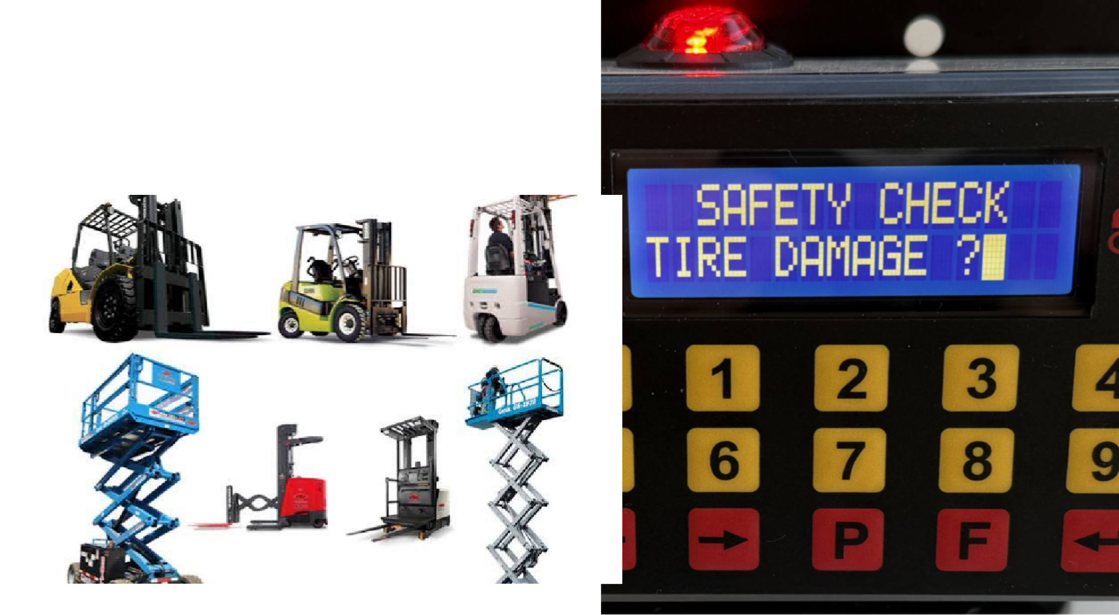
OSHAX
Safety Assured
Automatic Operator Daily Safety Check Compliance Recorder For Material Handling Vehicles

Slide 2

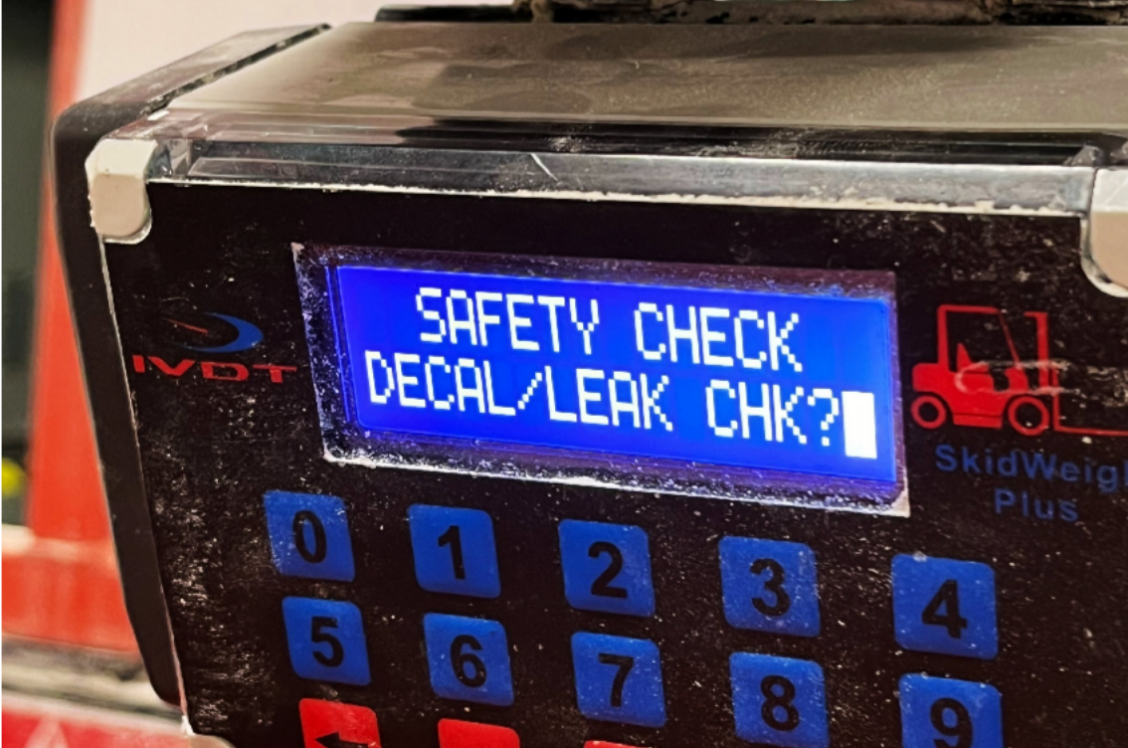
The Problem with Paper?
Paper based and manual forklift safety checklists introduce severe operational, financial, and legal vulnerabilities to material handling operations. Relying on operators to manually fill out physical clipboards or spreadsheets creates systemic compliance gaps that leave companies exposed during regulatory audits.
Core Data Integrity Issues
0
1
0
2
0
’Pencil Whipping’: Operators frequently check off all "pass" boxes in a matter of seconds without physically inspecting the forklift. This fabricates a perfect safety record while leaving critical mechanical failures completely undetected.
Severe Data Lag: Physical checklists often sit in clipboard folders on the warehouse floor for days or weeks. Safety managers only discover severe safety violations long after the vehicle has been operated in a dangerous condition.
High Administrative Burden: Manually collecting, sorting, archiving, and typing paper records into digital spreadsheets consumes hundreds of administrative hours that could be spent on active facility safety.
3
0
4
Data Loss and Damage: Paper sheets are easily lost, destroyed by grease or water, or filled out with illegible handwriting, creating immediate gaps in required regulatory records.
LEAVING YOUR COMPANIES OPERATIONS AND MANAGEMENT VULNERABLE AND EXPOSED

Slide 3
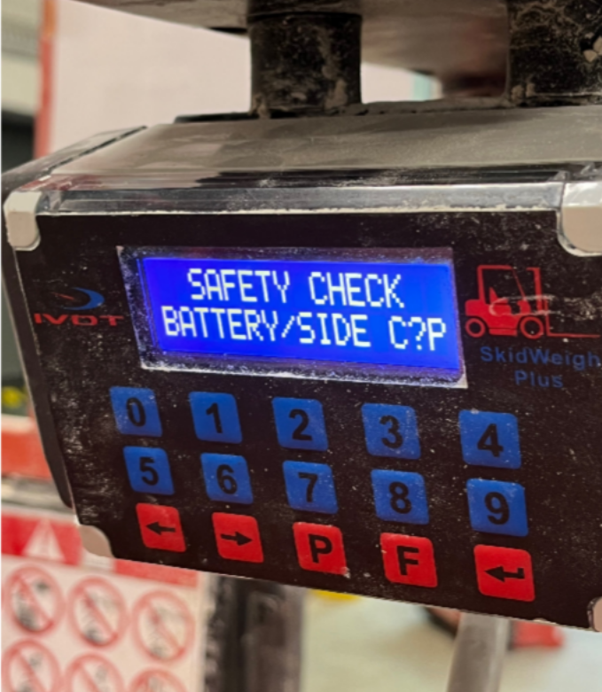
Safety and Equipment Risks
01
Undetected Mechanical Failures: When pre-shift checks are rushed or skipped entirely, critical defects like worn brakes, hydraulic leaks, or frayed seatbelts go unnoticed, leading to catastrophic equipment failure during a shift.
.
No Access Control: Manual tracking cannot stop unauthorized, untrained, or
uncertified drivers from stepping onto a forklift, starting the ignition, and driving away.
02
03
Lack of Accountability: Without verified digital timestamps and unique operator logins, it is incredibly difficult to pinpoint exactly which operator caused physical damage to a vehicle or when an incident occurred.
Avoid Risks

Slide 4
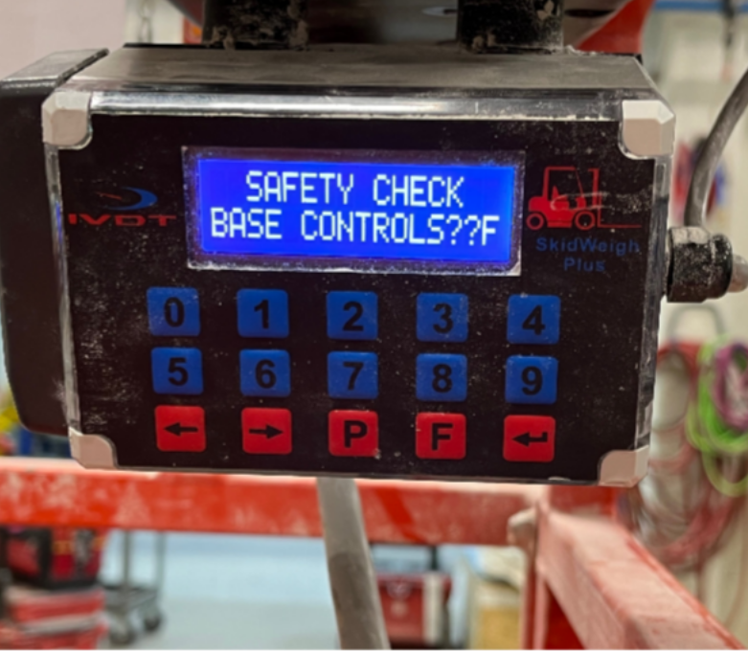
Regulatory and Legal Liabilities
01
OSHA Citations and Fines: Under regulatory frameworks like OSHA 1910.178(q)(7), industrial trucks must be examined before being placed in
service. Failing to produce clean, organized, daily audit-ready records during an inspection
results in severe financial penalties.
.
02
Negligent Entrustment Lawsuits: If a forklift accident causes injury, plaintiff attorneys will immediately subpoena daily inspection logs. Missing logs or a documented history of unaddressed vehicle defects provide legal proof of corporate negligence.
Digital recording systems, such as the IVDT OSHAX, directly satisfy the regulatory mandates of OSHA 29 CFR 1910.178 by converting vague, easily falsified paper check-boxes into hard, tamper-proof operational constraints. [1]
The table below aligns specific sections of the OSHA 1910.178 Standard with the exact mechanisms digital systems use to guarantee compliance.
Achieve 100% Compliancy

Slide 5
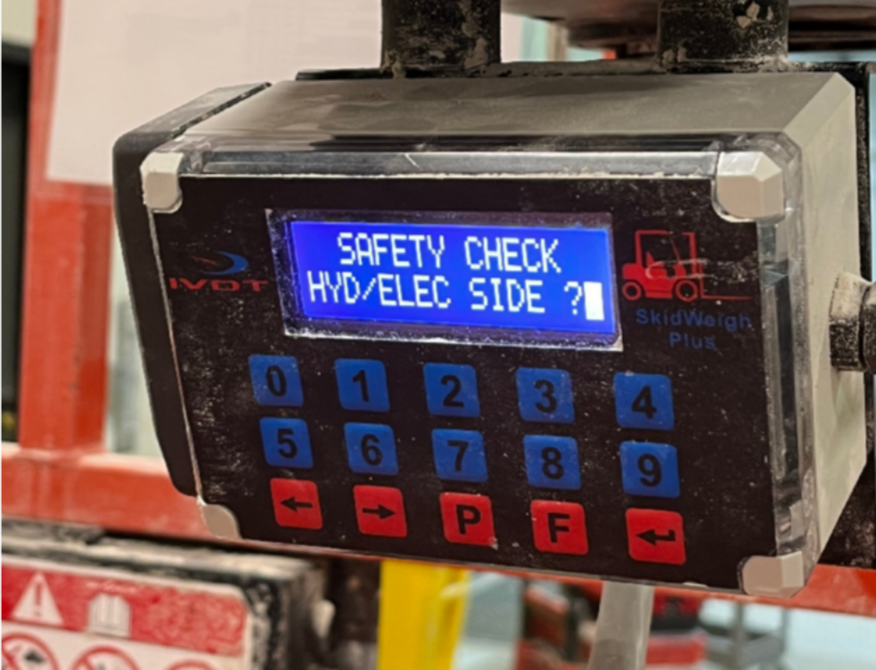
OSHAX
Automatic Operator Pre-Shift Safety Check Compliance Recorder for Material Handling Vehicles & Equipment
The IVDT OSHAX is a standalone automatic safety compliance recorder designed to ensure 100% OSHA and pre-shift inspection compliance across forklift fleets of all sizes. Manufactured by Integrated Visual Data Technology (IVDT), it provides a dedicated, aftermarket safety sol
Key Capabilities and Features
Mandatory Pre-Shift Enforcement: Activated immediately upon vehicle power-on. It keeps the vehicle in a "non-compliant state" with audible and visual alerts until the operator completes the required safety checklist.
Operator Access Control: Requires a PIN-based login via an integrated keypad or an optional RFID card/fob reader to identify and authorize drivers.
Guided Electronic Checklists: Prompts operators through an OSHA or Ministry-compliant pass/fail safety inspection checklist.
Data Logging: Securely logs the operator ID, vehicle ID, pass/fail inspection answers, and exact timestamps.
Non-Punitive Design: Employs real-time audio-visual alerts to enforce compliance rather than comp
IVDT STANDALONE FORKLIFT OSHA COMPLIANCE RECORDER

Slide 6
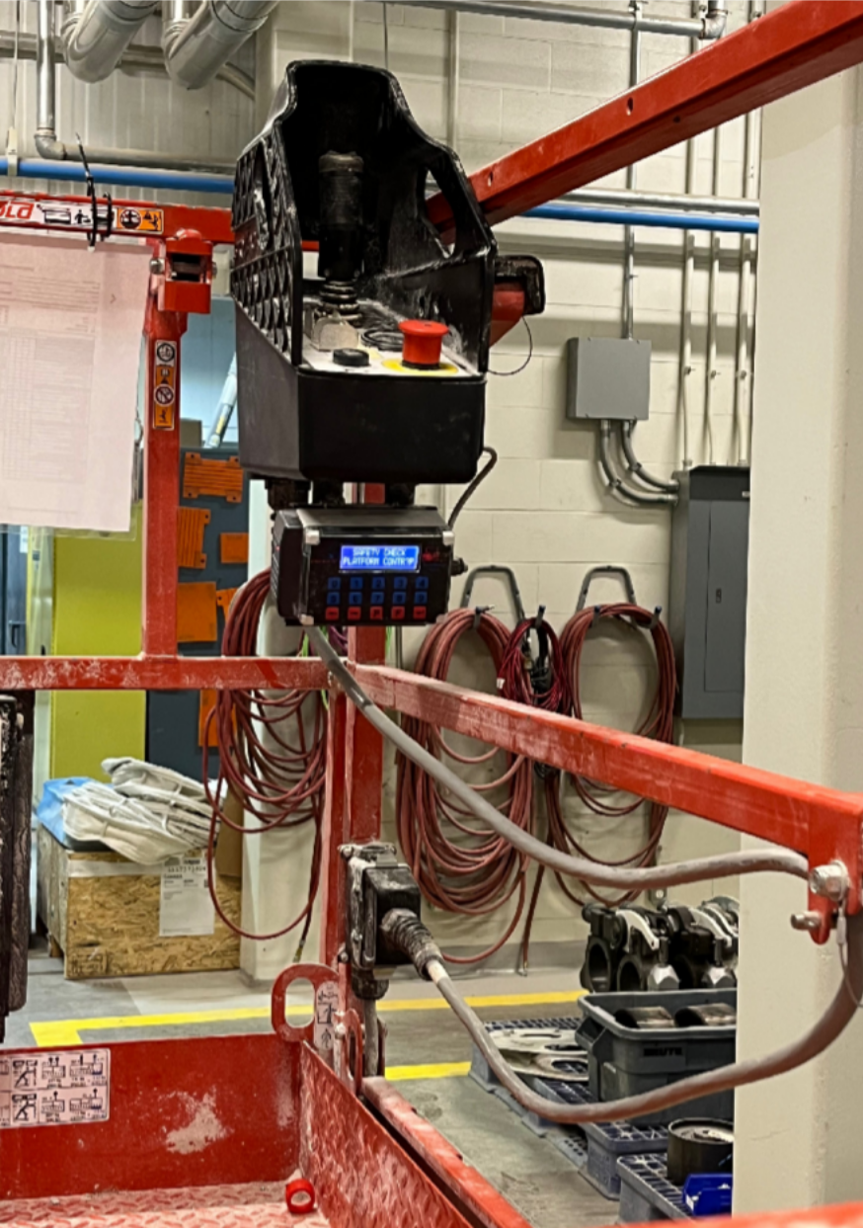
OSHAX: ADAPTIBILITY AND VERSATILITY
Fleet Integration and Data Management
Universal Compatibility: Works as an aftermarket system on any make, model, or operational voltage of OEM material handling equipment, making it ideal for mixed fleets.
Simple 1-Hour Installation: Connects quickly to the vehicle using just a basic two-wire electrical power hookup.
Audit-Ready Reporting: Stores historical data locally on a USB or SD card to easily generate compliance reports for safety audits.
Scalable Wireless Network: For larger operations, the system can expand wirelessly using a 900 MHz RF gateway network via the IVDT InfoHUBX platform to sync data directly to a local server without ongoing monthly cloud fees.
Data Extraction Pathways
The IVDT OSHAX handles compliance data extraction through two physical methods
designed to accommodate different fleet sizes:
Direct USB Extraction: For small fleets, compliance data logs directly to the internal CPU. A safety supervisor can plug a flash drive into the module to extract clean Excel (.xls) formatted reports, containing timestamps, operator PINs, and checklist responses.
InfoHUBX Wireless Gateway: For mid size and larger operations, the OSHAX upgrades into a real time system via the IVDT InfoHUBX communication gateway. It transmits pre-shift event results instantly via a local, 900 MHz license free RF Digi Mesh network directly to a local server terminal. Managers access this via an interactive LAN webpage portal to instantly sort compliance logs by driver, vehicle, shift, or checklist failure.

Slide 7
Integration with SkidWeigh Scales
For operations that require both weight verification and safety tracking, IVDT integrates pre-shift safety compliance directly into their premium SkidWeigh Plus ED3 on-board check weighing scales
OSHA COMPLIANCE
OSHAX’s audible strobe awareness system is activated and remains on until an authorized operator completes the pre-shift safety check.
Instead of requiring two separate hardware units on the dashboard, the SkidWeigh Plus Series combines both systems into one master interface.
OPERATIONAL WEIGHING
Once passed, the vehicle is released for normal use. The operator can instantly utilize the "Lift-N-Weigh" feature to calculate load weights within ±1% accuracy directly from the hydraulic lift
circuit with pressure transducer.

